Slide 1
Cloud-Readiness Checker
Research Question:
How to reduce the entry barrier of SMEs and provide initial guidance for the transformation process?

Slide 2
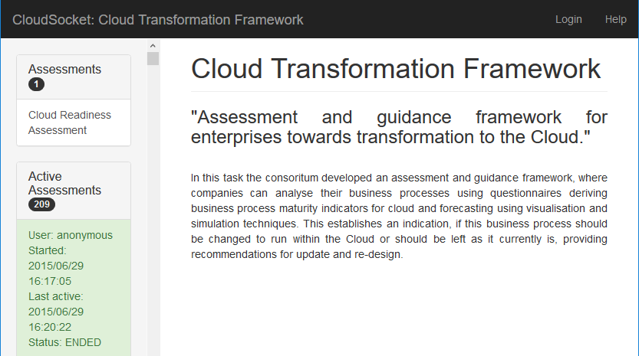
First Page
Self-check readiness:
Assessment
Guidance
business process maturity indicators
visualisation and simulation techniques
https://www.cloudsocket.eu/transformation/#

Slide 3
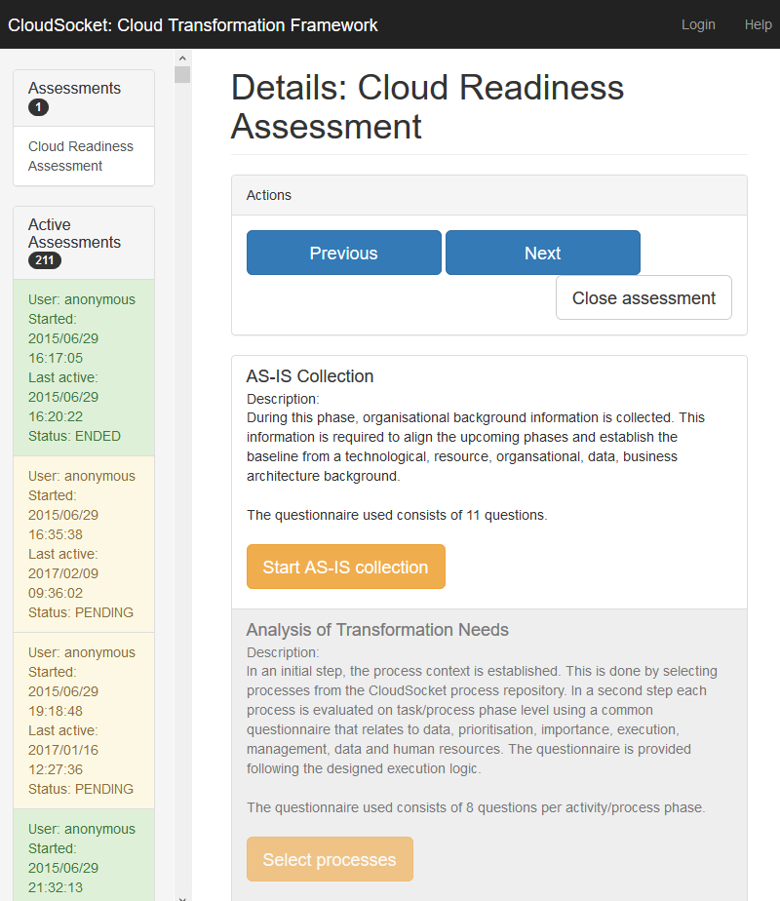
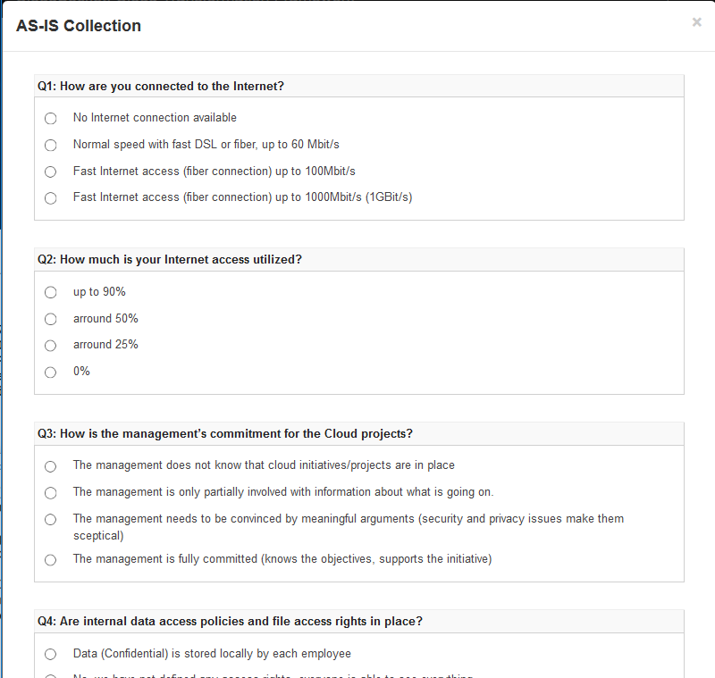
Cloud-Readiness Checker

