Slide 1
BPaaS Evaluation Environment Research Prototype
K. Kritikos
ICS-FORTH

Slide 2
Problem
Evaluate BPaaS to:
Check BPaaS performance
Find root-causes of problems (KPI violations)
Discover best BPaaS deployments
Identify adaptation rules for addressing KPI violations
Draw additional knowledge via process mining

Slide 3
Issues
Disparate information in different formats from different services / components
Need to harvest & integrate all relevant information across all levels for BPaaS evaluation
Current frameworks for KPI analysis & drill-down:
Cover 1or 2 layers at most
Adopt a non flexible & sometimes db-dependent approach for KPI evaluation
Limited set of fixed KPI metrics considered

Slide 4
Solution
Adopt a semantic approach [1]
Semantic frameworks appropriate for information integration
Dependency information modelled via an Evaluation ontology
KPI modelling via OWL-Q [2] KPI extension
KPI Measurements linked to dependency information
Information harvested from different components, semantically lifted and linked

Slide 5
Solution
KPIs evaluated via SPARQL queries
Flexible exploration of possible KPI metric space
Transformation from OWL-Q KPI to SPARQL
Consideration of KPI metric hierarchy, BPaaS dependencies and only available metric measurements
KPI drill-down based on KPI metric hierarchies
More precise root-cause analysis
KPI evaluation in bottom-up approach to form the KPI drill-down results

Slide 6
Evaluation Ontology
Covers BPaaS dependencies across different layers and for both type & instance level
Allocation decisions
I/O values for BPaaS workflow tasks
Adaptations performed over BPaaS & their status
Covers organisation aspects
Useful for different types of analysis:
KPI analysis & drill-down
Process mining (process regeneration, decision & organisation mining)
Best BPaaS deployment discovery
KPI violation-related event pattern detection

Slide 7
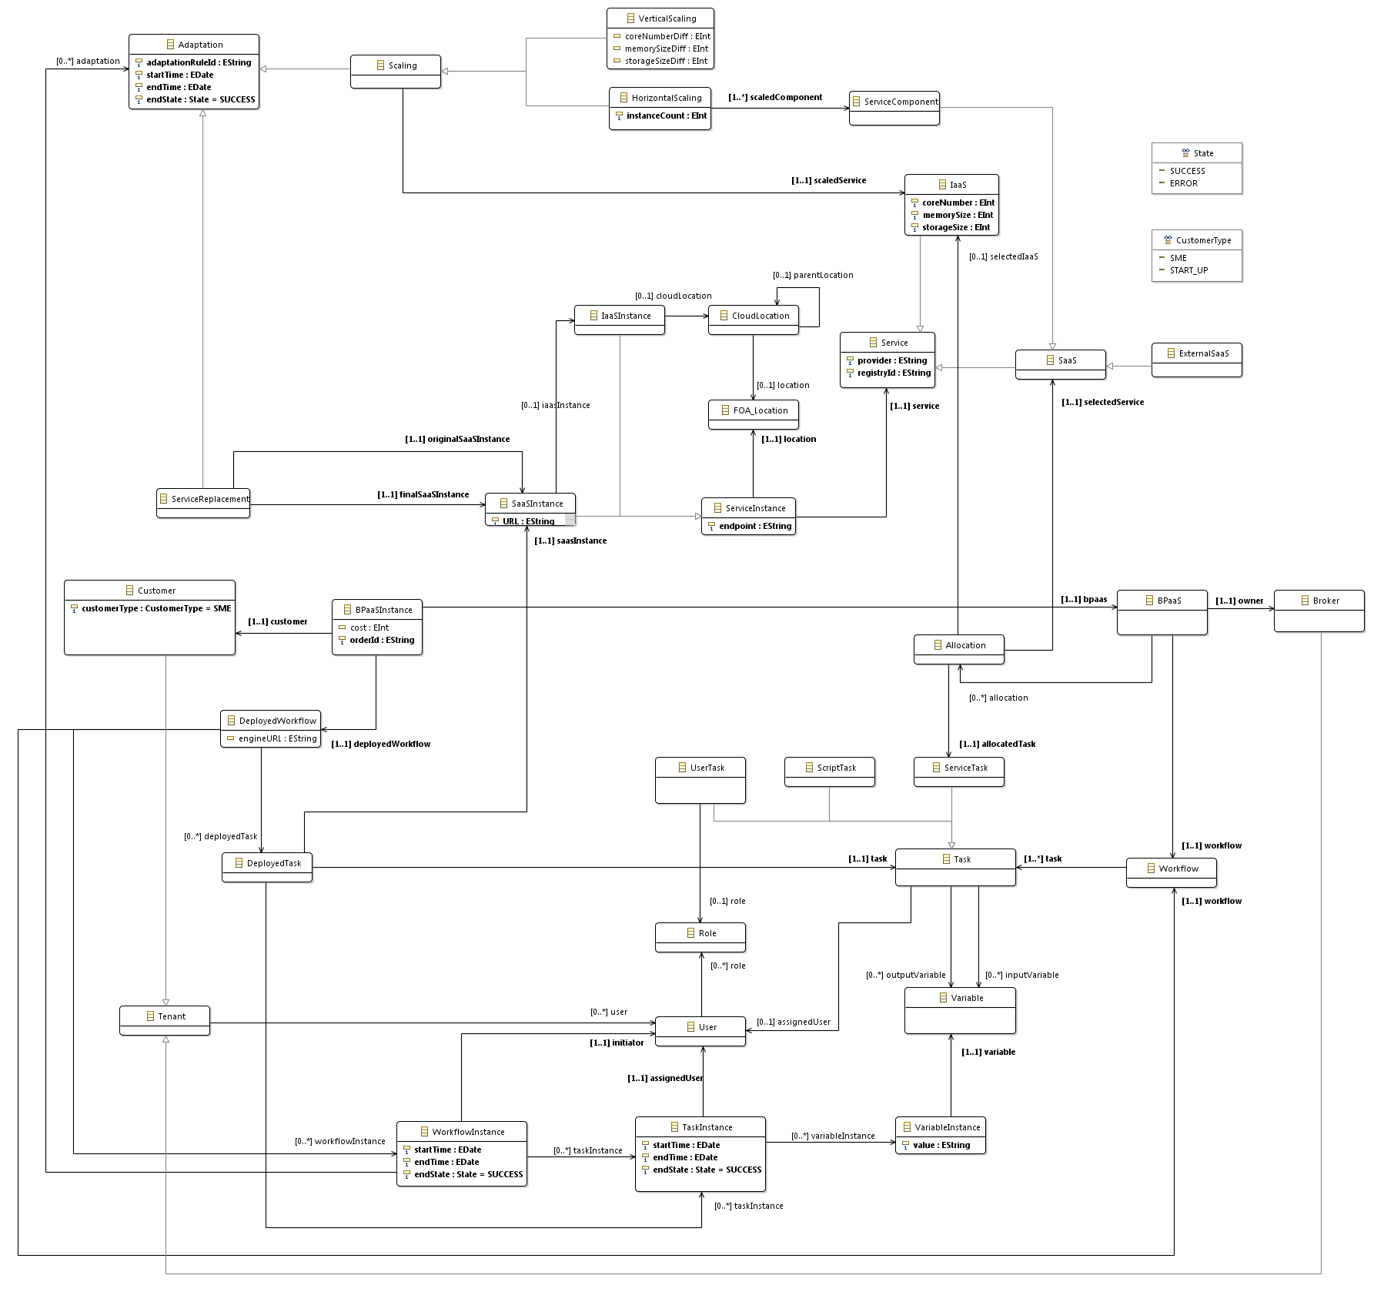

Slide 8
OWL-Q KPI Extension
Relies on OWL-Q [2]:
to cover appropriately all measurability aspects
builds upon specification facet
Main features:
KPI a kind of simple (metric) constraint with two thresholds (warning & violation)
Linkage of KPIs to goals
Formation of KPI hierarchies
Exploitation of both internal & external information sources in metric formulas
Human measurements modelling
KPI assessment modelling covering trends

Slide 9
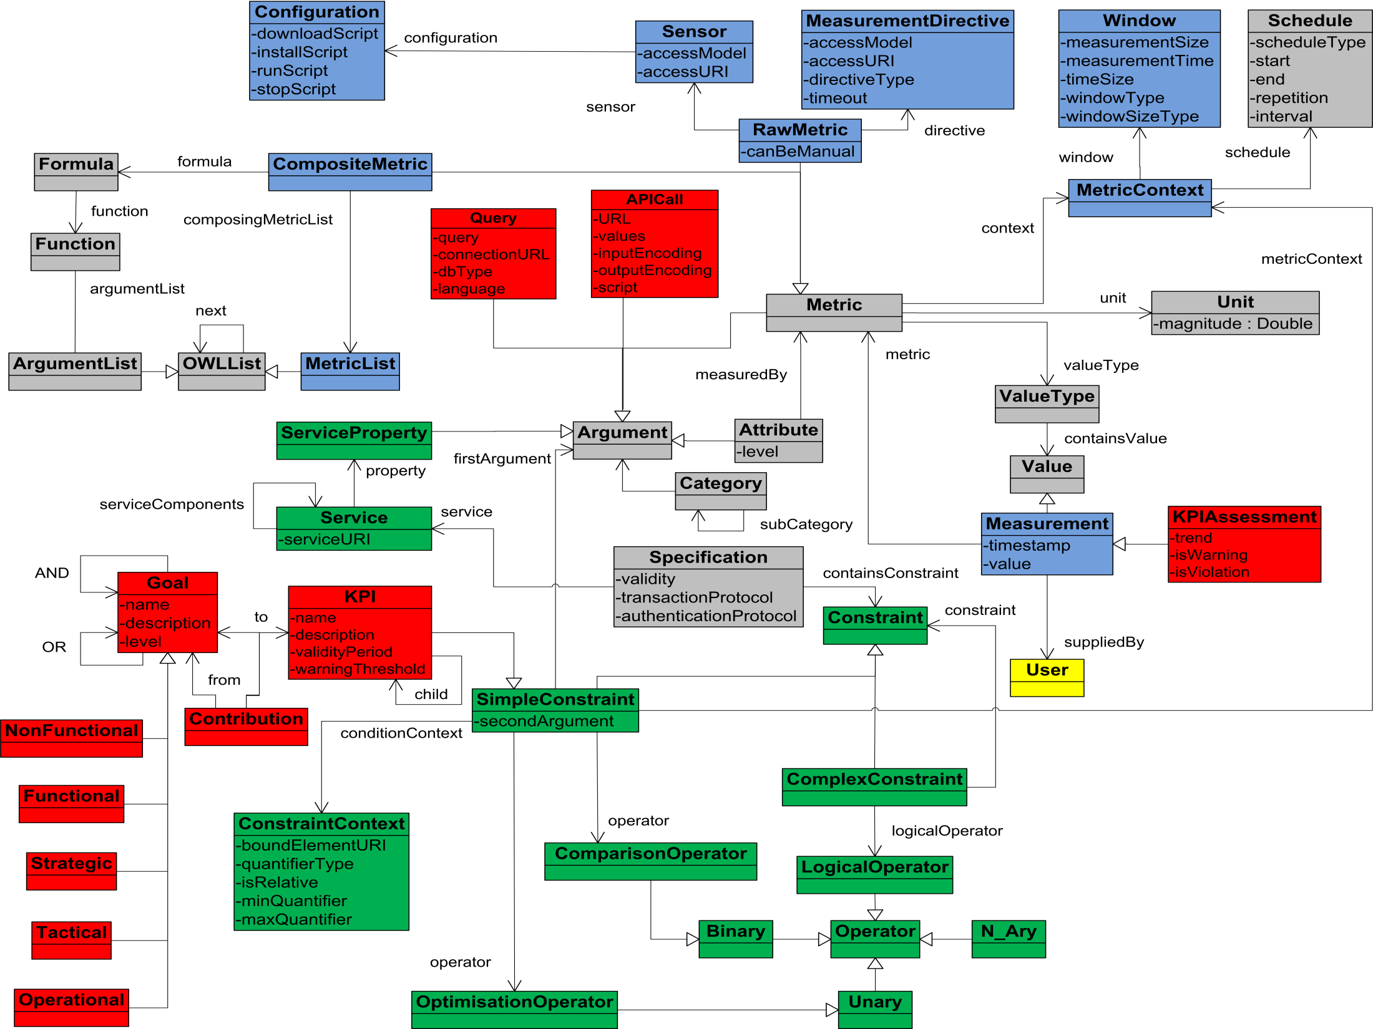

Slide 10
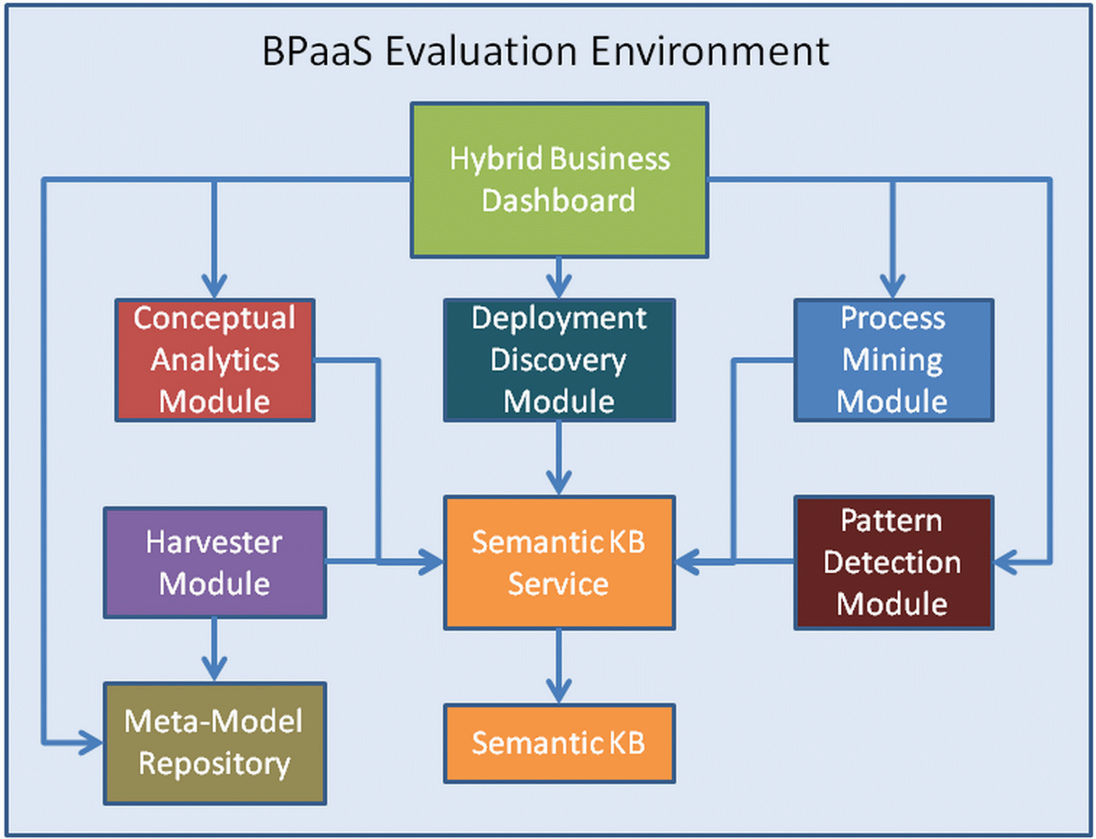

Slide 11
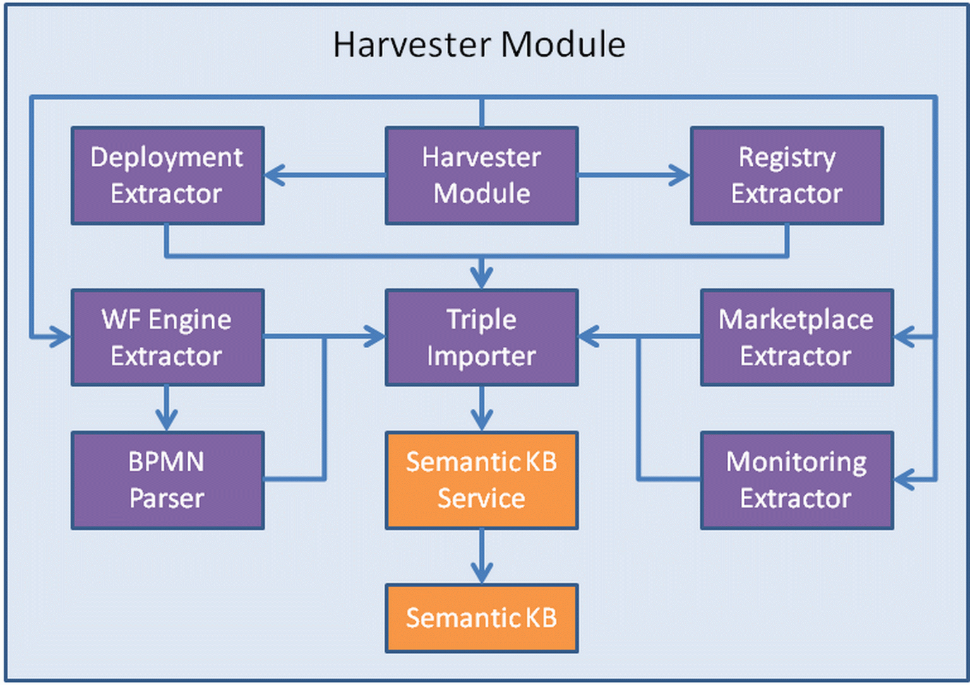

Slide 12
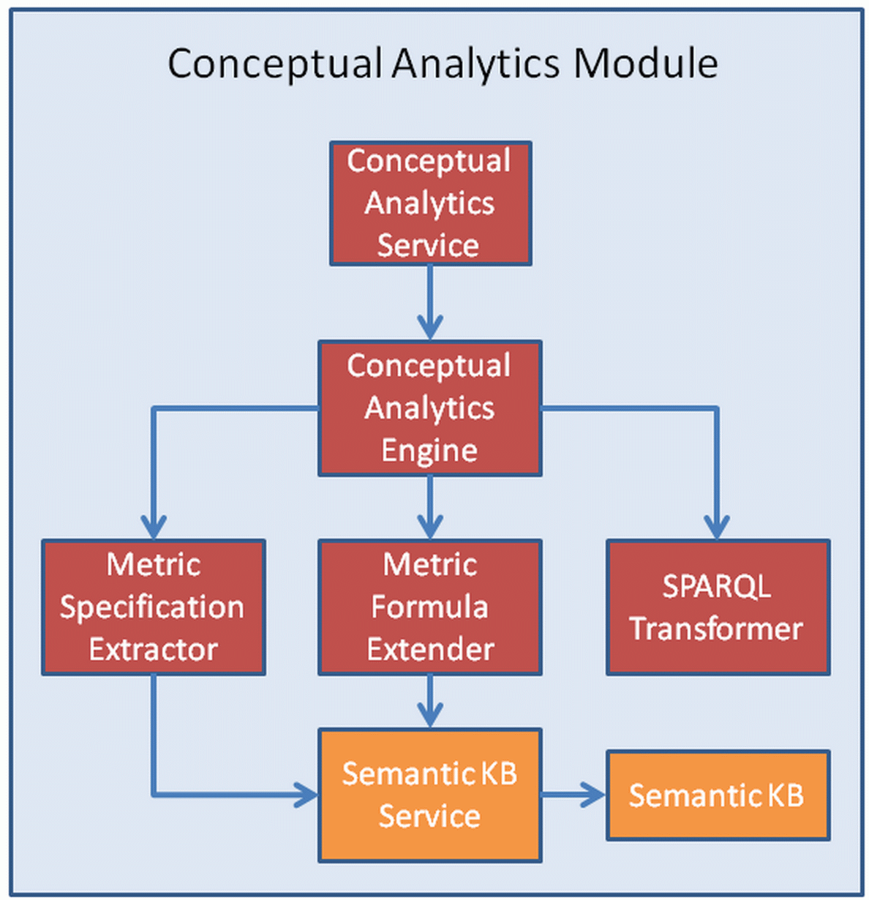

Slide 13
Showcase – BPaaS Harvesting & KPI Evaluation
Rely on Send Invoice use case
Perform SPARQL queries to show information linked into the Semantic KB
KPI drill-down based on availability

Slide 14
SPARQL Queries over Harvested Information
For each BPaaS, report task-to-SaaS mappings
For each BPaaS, report task-to-component-to-IaaS mappings
Show all BPaaS instances per each user

Slide 15
KPI Hierarchy for Availability
BPaaS Availability
BPaaS Level
Invoice Ninja Availability
YMENS CRM Availability
SaaS
Level
Omistack m1.small VM Availability
IaaS
Level

Slide 16
References
Kyriakos Kritikos et al.: D3.5 – BPaaS Monitoring and Evaluation Blueprints. CloudSocket Deliverable, December 2016.
Kyriakos Kritikos, Dimitris Plexousakis: Semantic QoS Metric Matching. ECOWS 2006: 265-274

