Slide 1

A Cross-Layer BPaaS Adaptation Framework
K. Kritikos¹, C. Zeginis¹, F. Griesinger², D. Seybold² , J. Domaschka²
1: ICS-FORTH, Greece
2: University of Ulm, Germany
FI-Cloud 2017 Conference, 2017/08/22

Slide 2
Outline
Problematic
Solution Overview & Architecture
CAMEL Overview & Extensions
Validation
Future Work Directions

Slide 3
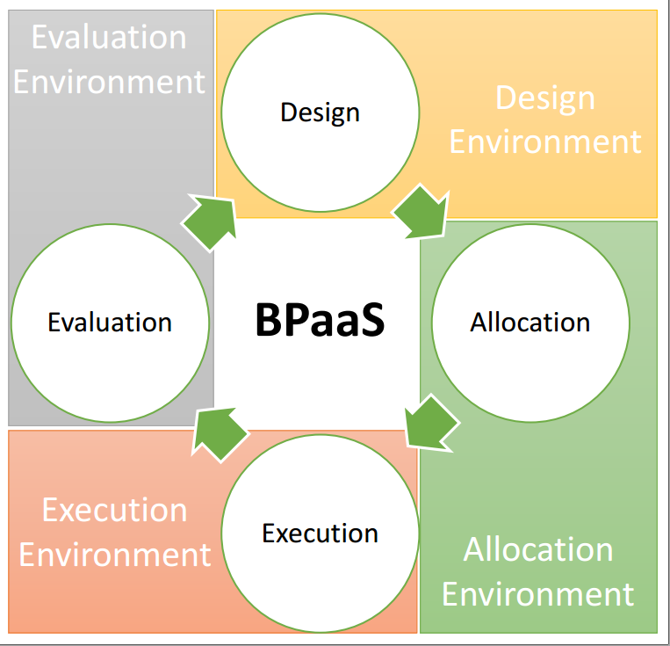
Problematic – Issues
Flexibility & cost reduction in BPs via the cloud
  Business process as a Service (BPaaS)
Need to handle whole lifecycle of BPaaS

Slide 4
Problematic – Issues
Focusing on Execution activity, there exists the need to:
  Monitor & Adapt BPaaS in a cross-layer manner to sustain a certain service level
Issues
  Many layers involved: IaaS, PaaS, SaaS, BPaaS
  Need for flexibility in metric specification & computation
  Need to realise layer-specific adaptation mechanisms
  Need to coordinate such mechanisms to deal with complex, problematic situations

Slide 5
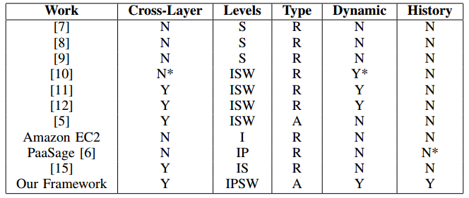
Problematic – Related Work Analysis
Our Solution

Slide 6
Solution Overview
Overall BPaaS Management: CloudSocket project
  Model-based approach for business-to-IT alignment & BPaaS provisioning
  Lifecycle activity-specific environments
BPaaS Monitoring:
  Flexible metric specification via CAMEL [1]
  Distributed monitoring approach across layers & clouds
    CAMEL metric computation formulas/trees cover the measurability gap across layers & clouds

Slide 7
Solution Overview
BPaaS Adaptation:
  Composition of existing adaptation frameworks
    To cover all possible layers
  Pro- & re-active adaptation via:
    rule-based approach
    event correlation via execution history mining
    warning events
    semi-automatic production of adaptation rules
  Dynamic adaptation via concretisation & execution of abstract adaptation workflows specified in CAMEL
  Adaptation history recording & browsing

Slide 8
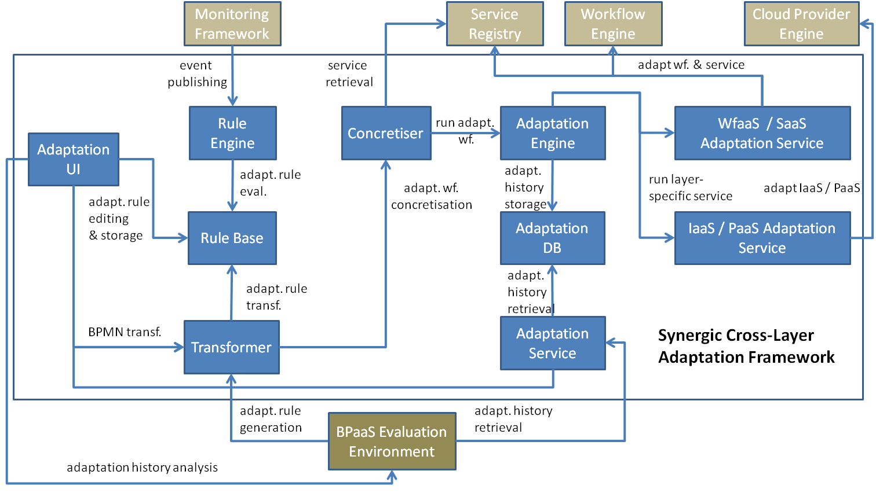
Solution Architecture

Slide 9
CAMEL – Overview
Multi-DSL focusing on capturing different domain-specific aspects of multi-cloud applications:
  Deployment, Requirement, Provider, Organisation, Location, Security, Metric, Scalability, Value Type, Unit
Produced from existing languages (e.g., CloudML [2], Saloon [3]) & new ones (SRL [4])
Use of OCL rules for integration & semantic domain validation

Slide 10
CAMEL – Overview
Based on Eclipse EMF
  Default tree-based editor
  Programmatic support
Text-based editor for devops based on XText technology
More details:
  www.camel-dsl.org
  www.github.com/camel-dsl:
    Meta-model
    Domain-code
    Text-based editor code

Slide 11
CAMEL – Overview
Monitoring:
  Specification of metric (computation) trees
  Metric conditions
  Metric scheduling & measurement window
Scalability
  Scalability rules mapping events to scaling actions
  Both horizontal & vertical scaling actions supported
  Events can be simple or composite
    Simple events map to metric conditions
    Composite events to event composition via temporal or logical operators

Slide 12
CAMEL – Extension
Capability to specify complex adaptation actions instead of just scalability rules
  Simple actions (SimpleAdaptationTask) mapping to layer-specific adaptation capabilities
    Scale-in/out, Scale-up/down, Migration, Service Replacement, Workflow Recomposition, Task Add/Modify/Replace/Omit
  Composite actions (CompositeAdaptationTask) mapping to a combination of actions via well-known control-flow constructs
    Sequence, Parallel, Conditional, Switch
Complex adaptation behaviour specified abstractly
  Freedom to choose from alternative implementations of layer-specific simple adaptation actions

Slide 13
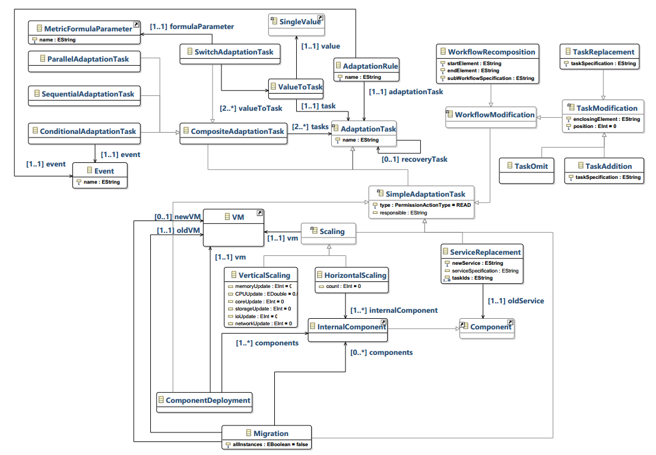

Slide 14
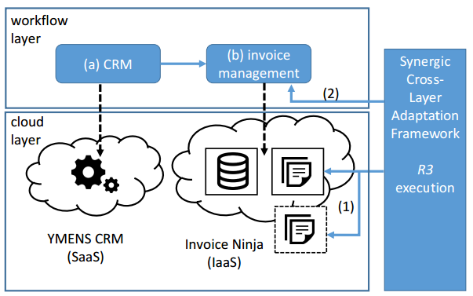
Validation
Cross-Layer Adaptation Scenario

Slide 15
Validation
Initial Rule Set:
  R1: cpu_viol(i_ninja,send_invoice) → hscale(i-ninja)
  R2: down(i_ninja,send_invoice) → re-run (i-ninja)
R2 covers non-permanent failures
New rule is introduced by expert via CAMEL to handle permanent failures
  R3: down(i_ninja,send_invoice) ∧ failed(R2) →
  seq(migrate(i_ninja), s_replace(i_ninja,send_invoice))

Slide 16
Future Work
Thorough solution validation & testing
Devise of sophisticated adaptation workflow concretisation algorithm
Development of:
  New adaptation capabilities
  Alternative implementations of existing ones
Dynamic injection of developed adaptation capabilities
Adaptation history analysis

Slide 17
References
A. Rossini, K. Kritikos, N. Nikolov, J. Domaschka, F. Griesinger, D. Seybold, D. Romero, D2.1.3 –
CloudML Implementation Documentation (Final version), PaaSage project deliverable, 2015.
N. Ferry, A. Rossini, F. Chauvel, B. Morin, A. Solberg, Towards model-driven provisioning, deployment, monitoring, and adaptation of multi-cloud systems, in: L. O’Conner (Ed.), Proceedings of CLOUD 2013: 6th IEEE International Conference on Cloud Computing, IEEE Computer Society,
ISBN 978-0-7695-5028-2, 887–894, 2013.
C. Quinton, D. Romero, L. Duchien, Cardinality-based feature models with constraints: a pragmatic
approach, in: T. Kishi, S. Jarzabek, S. Gnesi (Eds.), SPLC 2013: 17th International Software Product
Line Conference, ACM, 162–166, 2013
K. Kritikos, J. Domaschka, A. Rossini, SRL: A Scalability Rule Language for Multi-cloud Environments, in: CloudCom, IEEE, 1–9, 2014.

