Slide 1
Cross-layer monitoring and adaptation
K. Kritikos, C. Zeginis, D. Plexousakis
ICS-FORTH

Slide 2
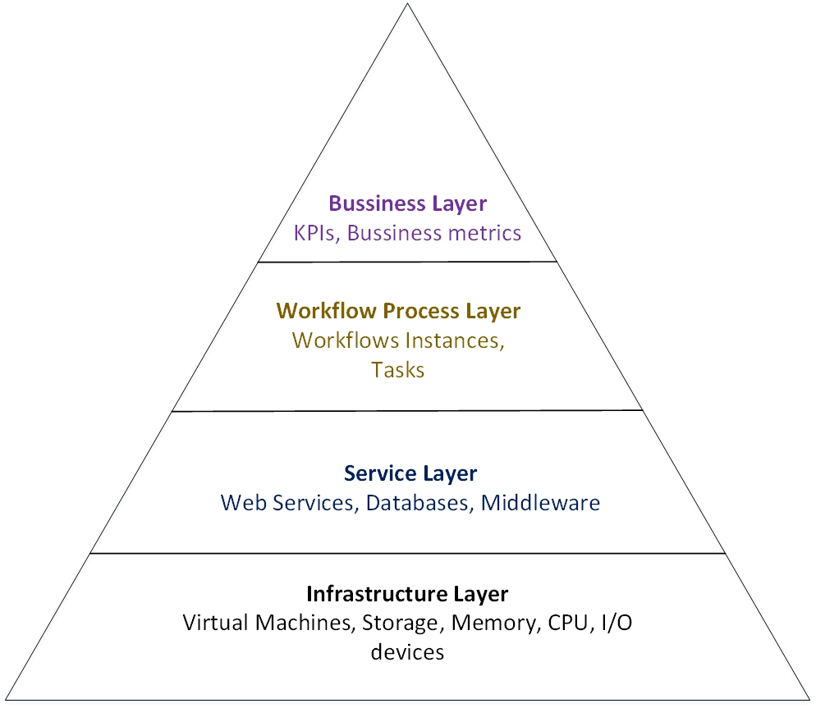
Functional Layers Pyramid
Monitoring and Adaptation

Slide 3
Monitoring Framework Architecture
Infrastructure Monitoring Manager
Service Monitoring Manager
Infrastructure Metrics Aggregator
Service Metrics Aggregator
pub/sub
pub/sub
Metrics
Assessment
DB
Metrics
Assessment
DB
pub/sub
Workflow Monitoring Manager
Workflow & Cloud Dependency Aggregator
pub/sub
Metrics
Assessment
DB
Pattern Discoverer
Central Cross-layer Dependency Metrics Aggregator
DB
ADAPTATION ENGINE

Slide 4
Cross-Layer BPaaS Monitoring
Cross-layer metric model to cover the measurement gap in same or across connected layers
Layer-specific monitoring mechanisms
Publish-subscribe for propagation of measurements from lower to higher-levels
SLO condition evaluation via CEP or UULM approach (everything is a metric)

Slide 5
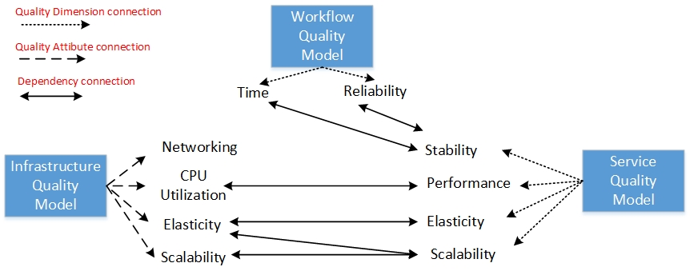
Cross-Layer BPaaS Monitoring
Quality models for Workflow, Service and Infrastructure layers
Workflow Quality Model
Time
Cost
Reliability
Security
Service Quality Model
Performance
Stability
Scalability/ Elasticity
Security
Infrastructure Quality Model
Performance
Scalability/Elasticity
Security
Cross-layer metric dependencies

Slide 6
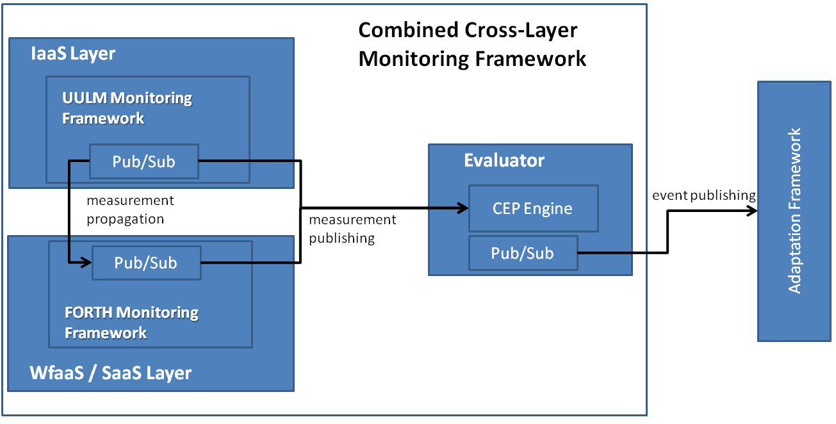
Cross-Layer BPaaS Monitoring

Slide 7
Cross-Layer BPaaS Adaptation
Adaptation actions as methods of services in each layer (e.g., scale-out as method of Cloud Provider Engine)
Rule Engine follows current situation and triggers adaptation rules
Rule triggering leads to adaptation workflow execution via a Workflow Engine
Dynamic selection of adaptation actions based on current situation and broker requirements
Semi-automatic enhancement of adaptation rule knowledge via BPaaS Evaluation Environment

Slide 8
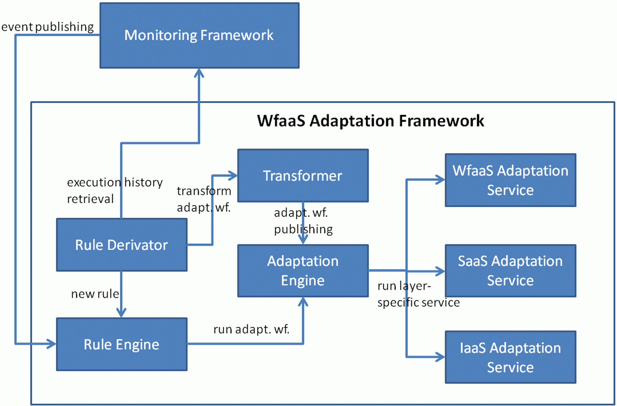
Cross-Layer BPaaS Adaptation

