Slide 1
WP3: BPaaS Research Execution Environment
PaaS Orchestration and Adaptation
Notes:
Now as the bundle is complete, we can start with the Execution Environment. For that I will present you the PaaS Orchestration and Adaptation.

Slide 2
WP3: BPaaS Research Execution Environment: PaaS Orchestration and Adaptation
Research Problem:
How can we make use of Cloud providers on all layers?
➔ Orchestration
How can we adapt the deployment in a cross-layer way to fit the current needs?
➔ Adaptation
Notes:
Research questions -> Two Parts
Handover from Allocation Environment as the BPaaS bundle is created
Shortcomings of the Execution Environment
Currently only deployment on IaaS layer → Description and selection of service and provider is restricted
No means of exchanging services between layers
No means of monitoring external services in a unified way

Slide 3
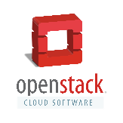
Motivating Example
Something happens to a component on the IaaS cloud provider.
Ensure a certain response time and availability.
Public IaaS cloud
BPaaS Bundle
Public PaaS cloud
Migration should happen.
Allowed and Availabe Cloud Infrastructures / Providers

Slide 4
Current State: Orchestration
The Cloud-DSL CAMEL was currently restricted to describe components on IaaS layer
The Cloud Provider Engine only provisioned services on the IaaS layer
Most other current Cloud DSLs have single layer-specific descriptions
1
*
„Sword“ → IaaS abstraction
Component
Configuration
Scripts

Slide 5
Solution Approach: Orchestration of PaaS components
Specification
Execution
PUL
PaaS Unified Library
Extensions
Extensions and Integration
Notes:
Step 1: Orchestration of PaaS components
Extension of CAMEL
Integration and Development of PaaS Unified library into Cloud Provider Engine
Extension of Life Cycle Management
Step 2: Management of Comprehensive Adaptation Scenarios
Extension of CAMEL
Extension of Monitoring Solution by externally hosted services
Development of Adaptation Management component that exposes the Cloud Provider Engine

Slide 6
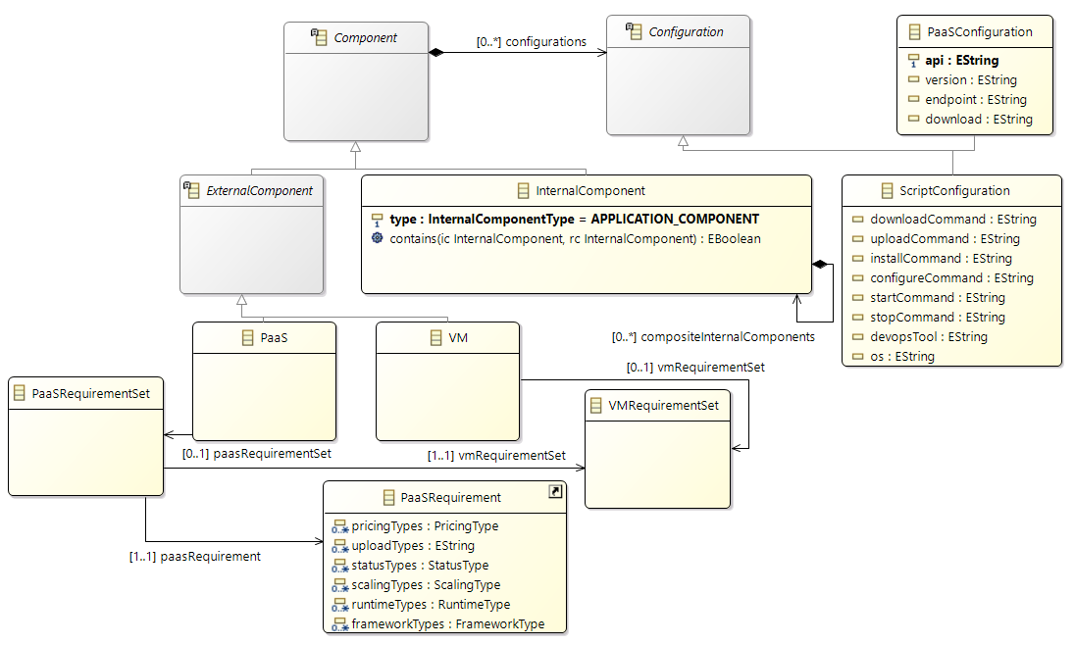
Solution Approach: Orchestration of PaaS components
CAMEL extensions towards PaaS deployment
Excerpt from the CAMEL configuration additions:
PaaS and IaaS configuration come along with the same
Component description
Combine PaaS-specific requirements and re-use hardware requirements

Slide 7
Solution Approach: Orchestration of PaaS components
CAMEL extensions towards PaaS deployment
Example as generated from Allocation Environment:
Multiple configurations allowed in respect to the underlying host.
<internalComponents
xsi:type="deployment:InternalServiceComponent"
name=“InvoiceNinja" …
<configurations
xsi:type="deployment:PaaSConfiguration"
name="CardDesignerPaaSConfiguration"
api="PUL"/>
<requiredHost
name="InvoiceNinjaRequiredHost"/>
</internalComponents>
PaaS configuration for a certain PaaS interface. IaaS configuration can happen as before in scripts.
Requirements of the platform are defined in the required host, e.g. Java or software components.
Host requirements are cross-layered
➔ Abstraction

Slide 8
Solution Approach : Orchestration of PaaS components
PaaS Unified Library
Abstraction from concrete provider APIs to support many at once
Integrated from SeaClouds projects by Atos
Enhanced to allow for better orchestration from Cloud Provider Engine
Higher abstraction → environmental independency of calls
Addition of more PaaS providers

Slide 9
Solution Approach: Orchestration of PaaS components
Extension of Life Cycle Management in Cloud Provider Engine
Extended the Component Model of the Cloud Provider Engine
Created jobs for PaaS deployment
Ensured CAMEL and PUL interoperability (adapter)
Cloud Provider Engine
IaaS
Sword
Dagger
PUL
PaaS

Slide 10
Current State: Adaptation
CAMEL supports only
horizontal scaling
vertical scaling
Other Cloud DSLs have too generic workflow description
e.g. TOSCA with BPMN
Cloudiator supports only
CAMEL-compatible workflows

Slide 11
Solution Approach: Management of Comprehensive Adaptation Scenarios
Specification
Execution
Adaptation Management
Extensions
Extensions and Implementation
Notes:
Step 1: Orchestration of PaaS components
Extension of CAMEL
Integration and Development of PaaS Unified library into Cloud Provider Engine
Extension of Life Cycle Management
Step 2: Management of Comprehensive Adaptation Scenarios
Extension of CAMEL
Extension of Monitoring Solution by externally hosted services
Development of Adaptation Management component that exposes the Cloud Provider Engine

Slide 12
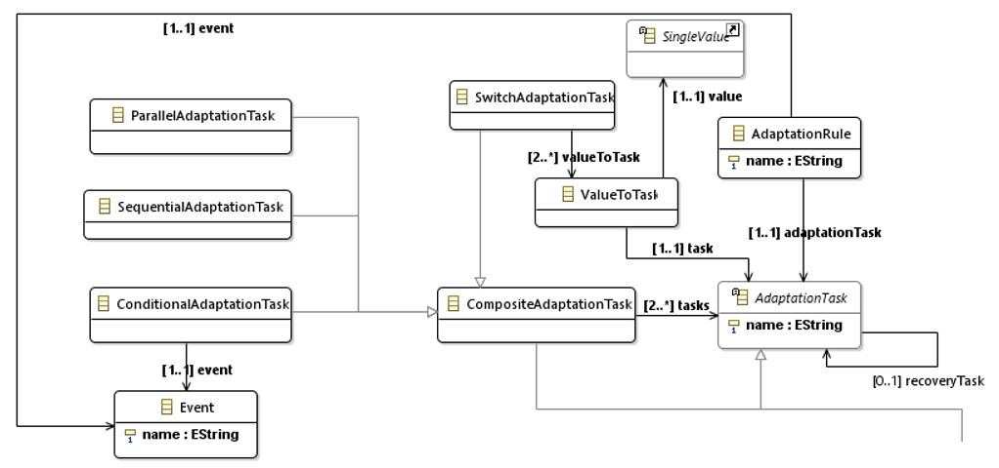
Solution Approach: Management of Comprehensive Adaptation Scenarios
Extension of CAMEL
Task composition

Slide 13
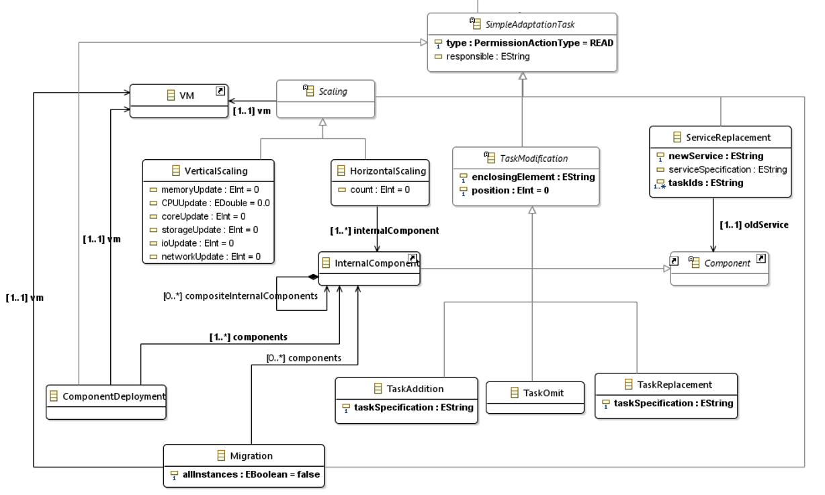
Solution Approach: Management of Comprehensive Adaptation Scenarios
Extension of CAMEL
Complex tasks instead of just scaling
Replace service with another one
Even change your application deployment and topology
Well-known
Scaling definitions
Task Modification
for Dynamic
React in case of violations by service migration

Slide 14
Solution Approach: Management of Comprehensive Adaptation Scenarios
Extension of Monitoring Solution by externally hosted services
Extended Cloud Provider Engine model by externally hosted monitor ➔ Allow the same for PaaS as for IaaS
Monitoring agent (Visor) in home domain of Cloud Provider Engine can now pull data from services that are not managed on IaaS
Execution Environment
MA
VM
IaaS
Cloud Provider Engine
Monitoring
Engine
PaaS
Env
PaaS
MA
Notes:
More in the later presentation about the Monitoring prototypes.

Slide 15
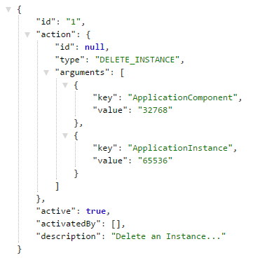
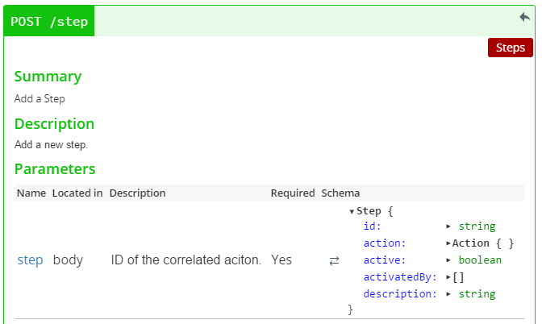
Solution Approach: Management of Comprehensive Adaptation Scenarios
Development of Adaptation Management component that exposes the Cloud Provider Engine and manages the adaptation plans
Plans are composed of single steps
Notes:
Adaptation Management REST interface:
API allows to add steps with their relation to create an adaptation plan in the end.
Steps are either activated by external events or precessors.
Implementation of Action Types as declared in the CAMEL specification.
Currently implemented migration actions and workflow engine adaptations.

Slide 16
Demonstration: Motivating Example
Public IaaS cloud
BPaaS Bundle
Public PaaS cloud

Slide 17
Demonstration: PaaS Orchestration
IaaS
Scripts
PaaS
PaaS
requirements
Deployment part of BPaaS bundle
Notes:
Aus Review raus lassen!

Slide 18
Demonstration: PaaS Orchestration
IaaS
orchestrates
Scripts
PaaS
PaaS
requirements
Cloud Provider Engine
Sword
translates
Dagger
orchestrates
PUL

Slide 19
Demonstration: Orchestration (Video / Live)

Slide 20
Demonstration: Adaptation Plan Description
Adaptation description for a migration in CAMEL as executed by the Adaptation Management component
<MonitorSubscription>
ResponseTimeRule
<Sensor>
ResponseTimeSensor
<Component>
InvoiceNinja
triggers
Already available entities of the Cloud Provider Engine
references
<AdaptationTask>
DeployComponent
<AdaptationTask>
UpdateWorkflowDescription
<AdaptationTask>
DeleteComponent
With description or reference to a VirtualMachine or PlatformEnvironment

Slide 21
Demonstration: Adaptation
<AdaptationTask>
DeployComponent
<AdaptationTask>
UpdateWorkflowDescription
<AdaptationTask>
DeleteComponent

Slide 22
Demonstration: Adaptation
<AdaptationTask>
DeployComponent
<AdaptationTask>
UpdateWorkflowDescription
<AdaptationTask>
DeleteComponent
Execution Environment
Cloud Provider Engine
Monitoring
Engine
Adaptation
Engine
Sword
Dagger
Workflow
Engine
PUL

Slide 23
Demonstration: Adaptation
<AdaptationTask>
DeployComponent
<AdaptationTask>
UpdateWorkflowDescription
<AdaptationTask>
DeleteComponent
Execution Environment
Cloud Provider Engine
Monitoring
Engine
Adaptation
Engine
Sword
Dagger
Workflow
Engine
PUL

Slide 24
Demonstration: Adaptation
<AdaptationTask>
DeployComponent
<AdaptationTask>
UpdateWorkflowDescription
<AdaptationTask>
DeleteComponent
Execution Environment
Cloud Provider Engine
Monitoring
Engine
Adaptation
Engine
Sword
Dagger
Workflow
Engine
PUL

Slide 25
Demonstration: Adaptation
<AdaptationTask>
DeployComponent
<AdaptationTask>
UpdateWorkflowDescription
<AdaptationTask>
DeleteComponent
Execution Environment
Cloud Provider Engine
Monitoring
Engine
Adaptation
Engine
Sword
Dagger
Workflow
Engine
PUL

Slide 26
Demonstration: Adaptation
<AdaptationTask>
DeployComponent
<AdaptationTask>
UpdateWorkflowDescription
<AdaptationTask>
DeleteComponent
Execution Environment
Cloud Provider Engine
Monitoring
Engine
Adaptation
Engine
Sword
Dagger
Workflow
Engine
PUL

Slide 27
Demonstration: Adaptation (Video / Live)

Slide 28
WP3: BPaaS Research Execution Environment: PaaS Orchestration and Adaptation
Added Value:
allow to deploy components at a bigger variety of Cloud providers
describe components on multiple ways and per Cloud layer on a provider-independent way
allow to describe adaptation plans, e.g. switch provider at run-time or adapt to new conditions

Slide 29
WP3: BPaaS Research Execution Environment: PaaS Orchestration and Adaptation

