Slide 1
A Cross-layer Monitoring Solution based on Quality Models
Damianos Metallidis, Chrysostomos Zeginis, Kyriakos Kritikos, and Dimitris Plexousakis

Slide 2
Agenda
Problem Statement
Introduction
Related Work
Monitoring Solution Architecture
Quality Metric Models
Quality Metric Aggregators
Process of Monitoring Log
Implementation
Evaluation
Conclusion and Future Work

Slide 3
Problem Statement
Monitoring all the functional layers of Service-based Applications (SBAs) is a challenging topic:
Workflow
Service
Infrastructure
The need for the creation of metric Quality Models that will cover Workflow, Service and Infrastructure layers
Definition of quality metrics, adapted to each of the layer’s properties
The need for a monitoring solution that will extensively cover the three layers being based on their respective Quality Models
Notes:
Need for cross-organizational workflows: Ena paradgima gia to ti akrivws einai to cross-organizational workflow
A cross-organizational workflow is a workflow that passes through more than one different SME-S
We should emphasize the need for monitoring in this stage

Slide 4
Introduction
Cross-organizational workflows for Small and Medium Enterprises (SMEs)
Correlation of Web service technology and Service-Oriented Architecture has become a necessity
In order to be correlated three stages are should be taken into consideration:
Virtualization hosting environments
Service Oriented software
Organizational workflows able to describe any kind of action within a SME
Need of monitoring has been raised in order to evaluate kind of actions taken in those three stages
Notes:
Need for cross-organizational workflows.
A cross-organizational workflow is a workflow that passes through more than one different SME-S
We should emphasize the need for monitoring in this stage

Slide 5
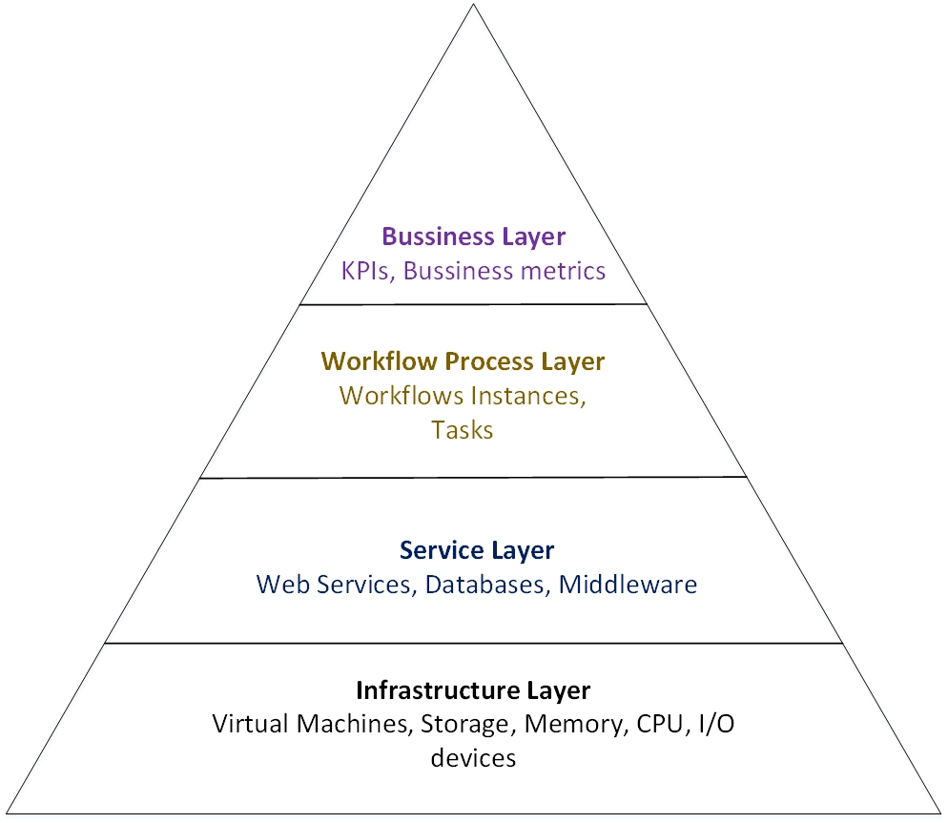
Functional Layers Pyramid

Slide 6
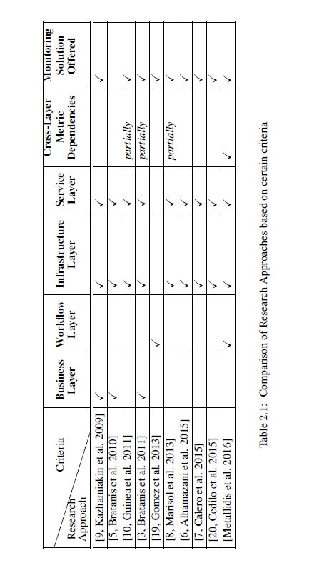
Related Work
Validation of QMs is performed according to empirical case studies without taking into account the relations that WM, IM and SM could have between them; instead they were coped with in isolation from each other
The fact that software services might be a functional piece of workflow has not been taken into account
Monitoring framework has been proposed mainly based on adaptation actions

Slide 7
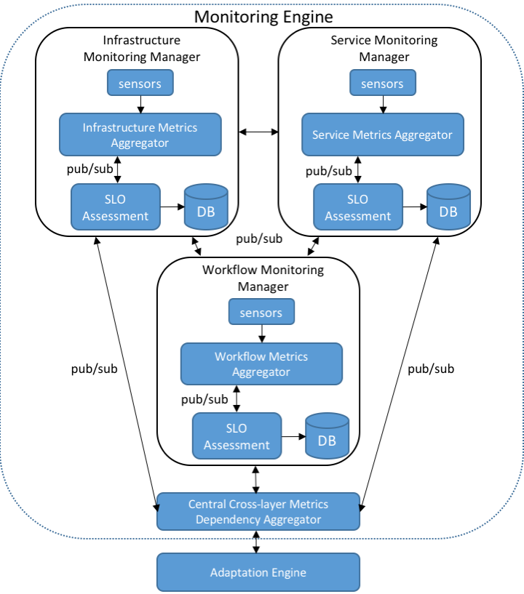
Monitoring Engine Architecture

Slide 8
Quality Metric Models
Workflow Quality Model
Quality dimensions of time, reliability, cost and security
Service Quality Model
Quality dimensions of performance, stability, scalability, elasticity and security
Infrastructure Quality Model
Quality attributes of performance, networking, CPU utilization, memory and storage, PaaS/IaaS scalability/elasticity and a quality dimension of security

Slide 9
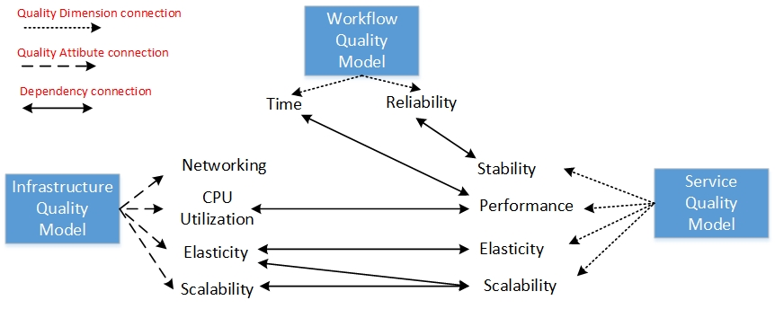
Cross-Layer Dependency Quality Model
Closing the gap between the three layers by defining a cross-layer dependency model

Slide 10
Quality Metrics Aggregators
Service Layer Aggregator

Slide 11
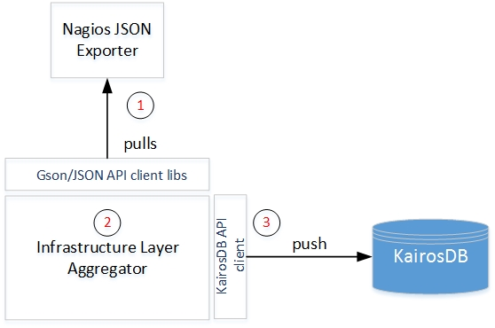
Quality Metric Aggregators
Infrastructure Layer Aggregator

Slide 12
Quality Metric Aggregators
Dependency/Workflow Layer Aggregator

Slide 13
Processing the Monitoring Log
A logic-based pattern discovery algorithm is adopted:
Discovers critical event patterns that lead to specific SLO violations
Splits the monitoring event stream according to the considered aggregate metric’s definition.
Defines the powerset of each event group.
Fills the contingency table of each considered individual set:
Calculates lambda (λ) score for each considered set:
Ranks the discovered association rules (λ>0).

Slide 14
Implementation
Nagios - The Industry Standard In IT Infrastructure Monitoring- is used for Infrastructure layer monitoring
Prometheus - Open source Monitoring tool - is used monitoring Web services
Activiti Workflow Engine enables monitoring at the workflow layer
Service Monitoring Tools comparison

Slide 15
Experimental Evaluation
Experimental Evaluation is based on Performance and Accuracy
Experiments are based on the VMware PaaS tool for private Clouds.
Physical Hardware: Intel Core i7-4 Cores 2.50 GHz,16 GB Ram, 300 GB SSD Hard Disk
Two VMs with 2 vCPUs, 2 GB Ram, 15 GB hard disk and OS of Centos7 64-bit
Two VMs with 2 vCPUs, 4 GB RAM and 20 GB hard disk and OS of Centos7 64-bit
In public cloud Infrastructure of University of Crete Data Center we have used one VM middle category with characteristics of:
2 vCPUs, 4 GB RAM, 100 GB Hard Disk drive and OS of Ubuntu 14.04 64 bit.

Slide 16
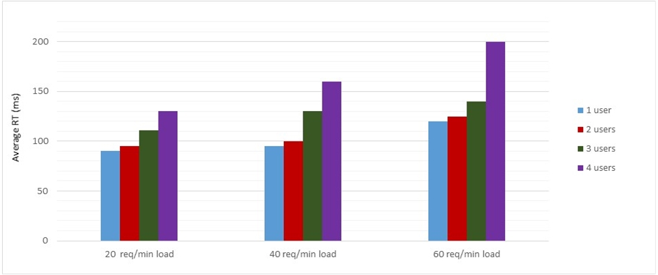
Experimental Evaluation
Average Response Time Diagram

Slide 17
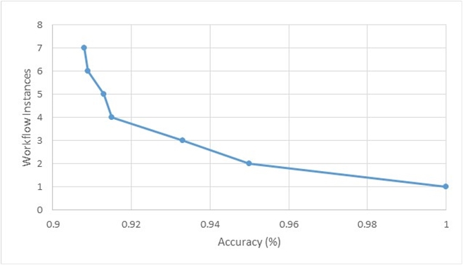
Experimental Evaluation
Monitoring System Accuracy
Notes:
The type is datapoints(received)/datapoints(expected)
Workload of 60 req/min.
We do not fail under 90% of accuracy.
The 10% percent loss of metrics and datapoints is due to the frequency of pulling values.
Auto boroume na to kanoume tackle allazodas to tuning tou kathe pote ginete pulling ta values . To tuning borei na ginei mesw ths OWL-Q gia future work.
In overall these seven runs we can observe that the deviation of the lost metrics is approximately 2 and the lost of data points is approximately 40, which is quite acceptable as we made the experiment under the workflow of 60 req/min.

Slide 18
Conclusions and Future Work
Conclusions
Quality Models (QMs) for the three layers and their dependencies
Provisioning of a Cross-Layer Monitoring System that implements the four QMs
Aggregation methods provided in all three layers
Experimental Evaluation of the proposed monitoring system
Future Work
Enrich our QMs and our dependency model
Definition and implementation of a Business metric Quality Model in order to deliver a full stack monitoring solution from the layer of Infrastructure until the Business one
Notes:
We have demonstrated three metric quality models along with a fourth one indicating the cross-layer dependencies and relations between quality metrics of the three QMs of WM, SM and IM. QMs that have been proposed are being covered by defining quality terms describing each of the layer's metric composability. To address that, we have created computation formulas that can be used to assign values on cross-layer depended-metrics, that could not been calculated unless dependencies are not defined

Slide 19
Questions?
Thank you

