Slide 1
Subsumption Reasoning for QoS-Based Service Matchmaking
Kyriakos Kritikos and Dimitris Plexousakis
ICS-FORTH

Slide 2
Presentation Outline
Problematic
Contribution
Background
System Architecture & Algorithm Presentation
Evaluation
Future Work Directions

Slide 3
Problematic
QoS grabbed researchers’ attention
plays an important role in all the service management lifecycle
paper focuses on discovery
Sophisticated QoS-based service matchmaking algorithms already proposed
3 categories:
ontology-based [1]: wrong use of ontology techniques, unary constraints only, scalability issues
constraint-based [2]: n-ary constraints but assumes common QoS term vocabulary
Mixed [3]: best of both worlds, perfect accuracy but potential for further performance improvement

Slide 4
Contribution
Followed ontology-based approach
Correct use of ontology techniques – subsumption
Developed smart matchmaking algorithms which exploit intelligent advertisement structures plus different ontology subsumption techniques to speed-up matchmaking
Might be better in performance wrt. state-of-the-art mixed approaches in certain circumstances:
No transformation of ontology descriptions to constraint models
No solving of multiple constraint models to infer the matchmaking

Slide 5
Background – Realisation Issues
Advert ≡ QoSProfile
ᴨ (≤10responseTime.AVGRespTMetric)
ᴨ (≥2responseTime.AVGRespTMetric)
ᴨ (≥100througput.AVGThrMetric)
ᴨ (≤ 120throughput.AVGThrMetric)
(B) Offer in DAML-QoS
using QoS; quarantees{ AvgRtTime>=2 and AvgRtTime<=10; ATHR>=100
and ATHR<=120 } (A) Offer in QRL
Advert ≡ Specification and (hasTerm some
(MeanResponseTime and (value some int[>= "2"^^int, <= "10"^^int]))) and (hasTerm some
(MeanThroughput and (value some int[>= "100"^^int, <= "120"^^int])))
(C) Offer in OWL-Q
Advert ≡ Specification and (hasTerm some
(MeanResponseTime and (value some int[<= “-2"^^int, >= “-10"^^int]))) and (hasTerm some
(MeanThroughput and (value some int[>= "100"^^int, <= "120"^^int])))
(D) Offer in OWL-Q (with negate)

Slide 6
Background – Constraint-Based Matchmaking Example
using QoS;
quarantees{
X₁>=2 and X₁ <=10;
X₂ >=100 and X₂ <=120;
X₁ <1
}
(C) 1st Constraint Problem
using QoS; quarantees{ AvgRtTime>=1 and AvgExTime<=12; ATHR>=80
and ATHR<=140 } (A) Demand in QRL
Advert ≡ Specification and
(hasTerm some
(MeanResponseTime and
(value some int[<= “-1"^^int, >= “-12"^^int]))) and (hasTerm some
(MeanThroughput and (value some int[>= “80"^^int, <= "140"^^int])))
(B) Demand in OWL-Q (with negate)
using QoS;
quarantees{
X₁ >=2 and X₁ <=10;
X₂ >=100 and X₂ <=120;
X₁ >12
}
(D) 2nd Constraint Problem
using QoS;
quarantees{
X₁ >=2 and X₁ <=10;
X₂ >=100 and X₂ <=120;
X₂ < 80
}
(E) 3rd Constraint Problem
using QoS;
quarantees{
X₁ >=2 and X₁ <=10;
X₂ >=100 and X₂ <=120;
X₂ > 140
}
(F) 4th Constraint Problem

Slide 7
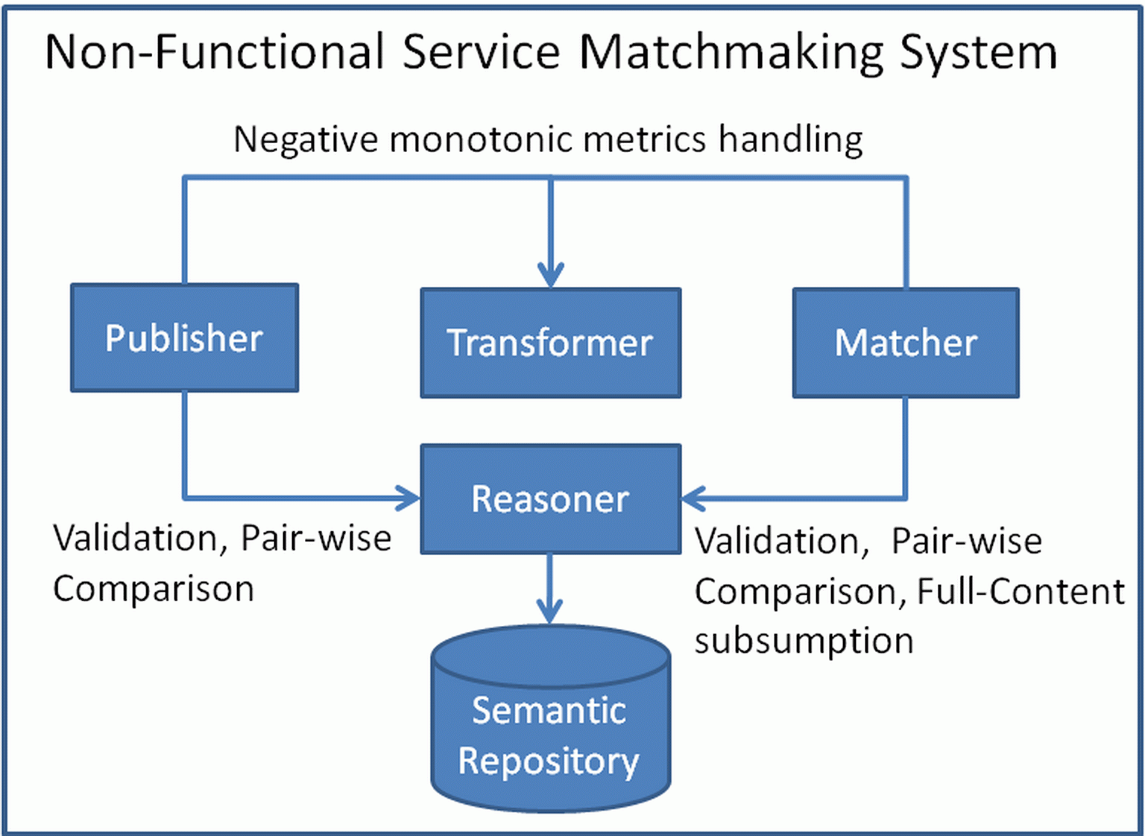
Approach Architecture

Slide 8
Proposed Algorithms – Naïve
Rationale: Load all offers on memory on demand for matchmaking. Offers just stored in repository when registered.
Offer Space Organisation: Just a hashset holding URIs of stored offers
Algorithm Core: Load all offers plus request on KB, perform classification, & obtain those offers subsumed by the request
Complexity:
Matchmaking:
Registration:

Slide 9
Proposed Algorithms – Incremental
Rationale: employ incremental classification to speed up matchmaking time
Offer Space Organisation: URI Hash set + KB
Algorithm Core
Matchmaking: Temporarily include request in KB, perform classification, retrieve offers subsumed by request, remove request
Registration: Load each offer on KB and perform incremental classification for every X offers stored
Complexity:
Matchmaking:
Registration:

Slide 10
Proposed Algorithms – Subsumes
Rationale: Classification does not scale well. Create own subsumes hierarchy based on SubMIPMM [3] and use it for matchmaking
Algorithm Core:
Matchmaking: Match request with each root node. If node subsumed, all descendants are also subsumed. Otherwise, visit recursively node’s descendants
Registration: Check relation of offer with root nodes. If offer subsumes node, it becomes its parent. If offer subsumed by node, visit node’s descendants recursively to find appropriate placement position. If offer not placed anywhere, it becomes root node

Slide 11
Proposed Algorithms – Subsumes – Matchmaking
R
O₁
O₂
O₃
O₁₁
O₁₂
O₂₁
O₂₂
LEGEND
Match/subsumed node
O₂₂₁
O₂₂₂
Fail match node
Matching
Parent-child relationship

Slide 12
Proposed Algorithms – Subsumes – Registration
O
O₁
O₁
O
O₁
O₁₁
O₁₂
O₁₁
O₁₁
O₁₂
O
LEGEND
Subsumed node
Subsumes node
Fail match node
Matching
Parent-child relationship

Slide 13
Proposed Algorithms – Subsumes
Complexity:
Matchmaking:
Best:
Worst:
Average:
Registration:
Best:
Worst:
Average:

Slide 14
Proposed Algorithms – SubsumesFrag
Rationale: Instead of comparing 2 specs each time, do this for C specs. Use incremental classification to construct the offer hierarchy
Offer Space Organisation: KB + URI hashset
Algorithm Core:
Matchmaking: Similar to Subsumes. Match root level in chunks of C nodes. If node matched, add also its descendants. If not, go deeper to its descendants
Registration: Register offers in KB and perform incremental classification every X offers

Slide 15
Proposed Algorithms – SubsumesFrag
Complexity:
Matchmaking:
Best:
Worst:
Average:
Registration:
As in Incremental:

Slide 16
Experimental Evaluation
Exploited experimental framework in [3]
Input:
WS-Dream [4] second dataset
Random dataset
Considered algorithms: proposed + SubMIPMM [3]
Implementation: Pellet [5] for subsumption reasoning & Ibex [6] for MIPP solving
Metrics: Average execution for matchmaking & registration
Each experiment step executed 30 times
Accuracy not considered as perfect

Slide 17
1st Experiment
Random Input
Number of offers from 40 to 640 with 100 as step

Slide 18
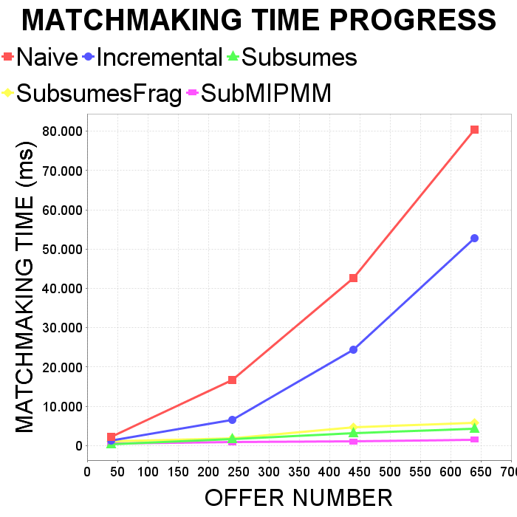
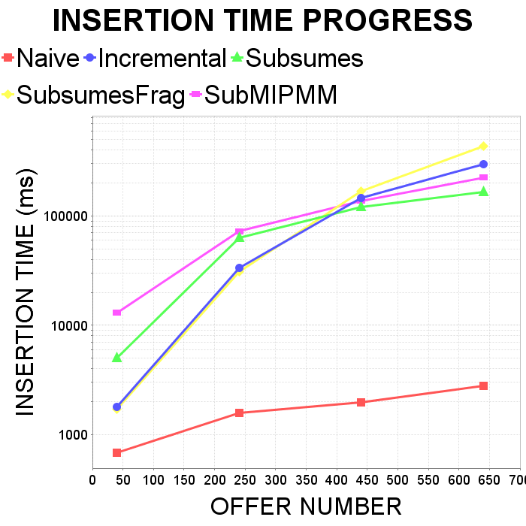
1st Experiment – Results

Slide 19
2nd Experiment
Random Input
Offer Number = 300
Metric number from 10 to 60 with 10 step

Slide 20
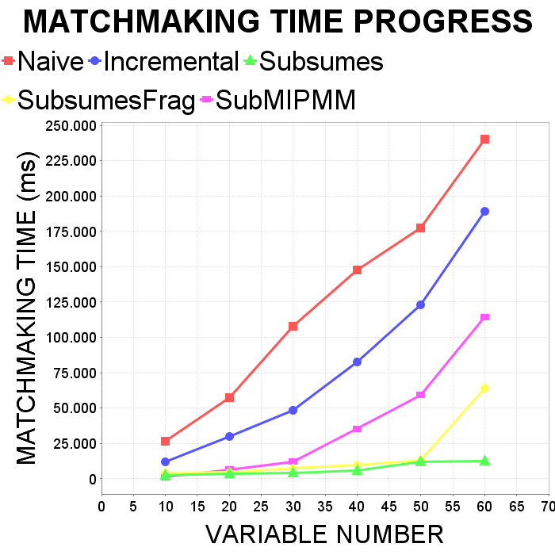
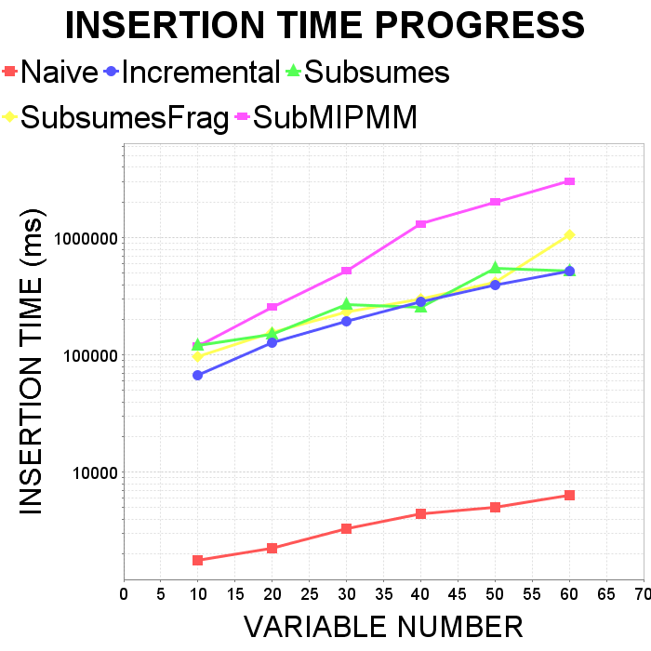
2nd Experiment – Results

Slide 21
3rd Experiment
Input: WS-Dream 2nd dataset
Offer number from 100 to 600 with 100 step
Metric number is constant: 2

Slide 22
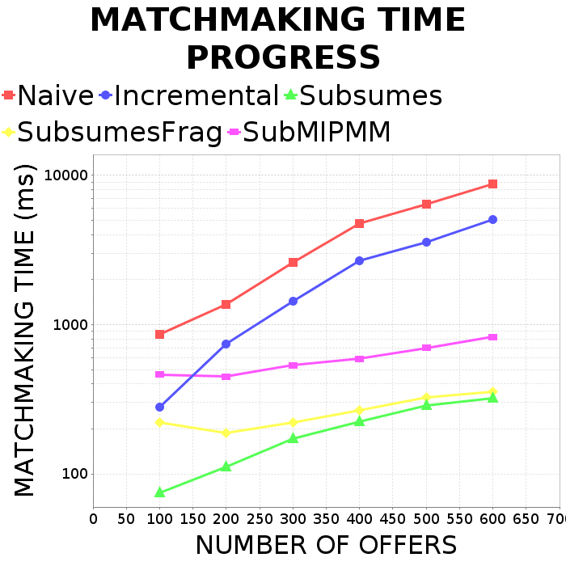
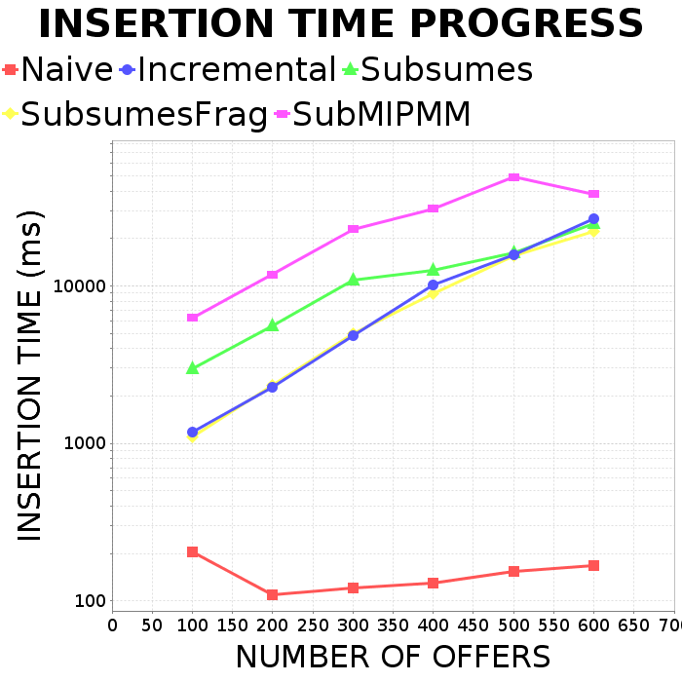
3rd Experiment – Results

Slide 23
Evaluation – Main Conclusions
Smart ontology-based approach can outperform state-of-the-art mixed one under real circumstances
Subsumes seems to be the best from proposed algorithms for both matchmaking & registration

Slide 24
Future Work
Further investigation of new smart algorithms
Check possibility to modify normal subsumption reasoning to deal with two main issues
Negation of constraints for negatively monotonic metrics
Bad performance in matchmaking
More thorough evaluation against the state-of-the-art
Couple the proposed algorithms with a functional matchmaker
Check for smart organisation for both functional & QoS aspect

Slide 25
References
Zhou, C., Chia, L.T., Lee, B.S.: DAML-QoS Ontology for Web Services. In: ICWS. p. 472. IEEE Computer Society (2004)
Cortés, A.R., Martín-Díaz, O., Toro, A.D., Toro, M.: Improving the Automatic Procurement of Web Services Using Constraint Programming. Int. J. Cooperative Inf. Syst. 14(4), 439–468 (2005)
Kritikos, K., Plexousakis, D.: Novel Optimal and Scalable Nonfunctional Service Matchmaking Techniques. IEEE T. Services Computing 7(4), 614–627 (2014)
Zhang, Y., Zheng, Z., Lyu, M.R.: WSPred: A Time-Aware Personalized QoS Prediction Framework for Web Services. In: ISSRE (2011)
https://github.com/Complexible/Pellet
www.ibex-lib.org

