Slide 1
Towards Combined and Functional and Non-Functional Semantic Service Discovery
Kyriakos Kritikos and Dimitris Plexousakis
ICS-FORTH

Slide 2
Presentation Outline
Problematic
Contribution
Evaluation
Future Work Directions

Slide 3
Problematic
Many service-based applications are designed & published
Need of accurate service discovery and composition techniques
Service discovery should focus on both functional and non-functional aspects & incorporate semantics
Current research mostly focuses on just one aspect and not both
Those approaches covering both aspects exhibit the following:
No consideration of best state-of-the-art aspect-specific solutions
Service semantics is not covered
No suitable performance and accuracy levels delivered

Slide 4
Contribution
Unified semantics-oriented architecture integrating aspect-specific discovery solutions
Development of novel combinations of state-of-the-art aspect-specific solutions
Experimental evaluation of performance of these combinations

Slide 5
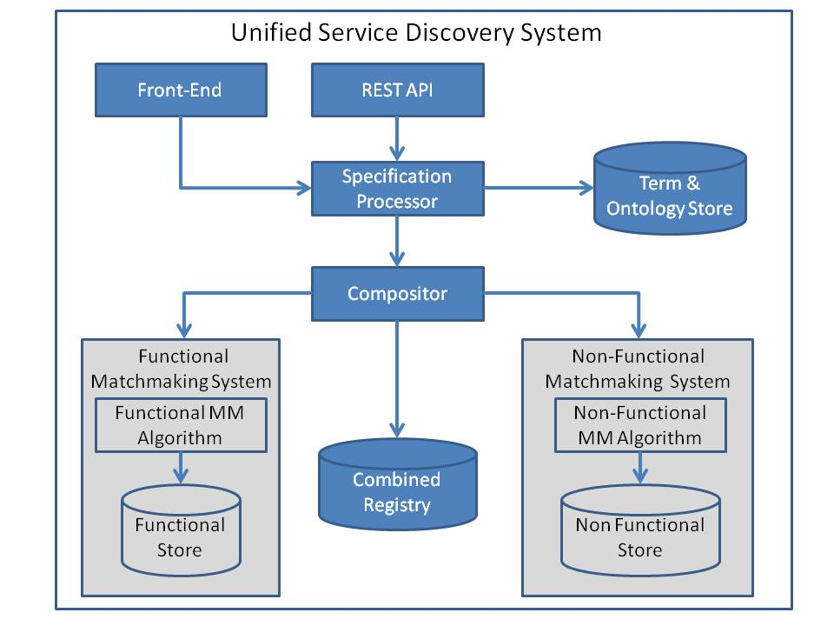
Unified Service Discovery Architecture

Slide 6
Unified Service Discovery Architecture
Interesting Features:
Independence from aspect-specific functionality
Any state-of-the-art semantic algorithm can be used
Consistent integration of aspect-specific algorithms
Transactional service registration & updating
Programming & web-based access
Secure access to some of the services offered
Independence from (semantic) service specification language
Requirements:
Each aspect specific algorithm should offer an entry point to its functionality (REST or programmatic)

Slide 7
Aspect-Specific Algorithm Combinations
Different criteria exploration
Control flow:
Sequence
(F-> NF): Functional matchmaking more restrictive than Nonfunctional matchmaking
Parallel: More resources but matchmaking speed-up
Smart structure for service advertisement organisation
Subsumes relations are exploited
Another way to speed up matchmaking
Subsumes metric: combSub (S₁, S₂) ≡ fSub (S₁, S₂) ∧ nfSub (S₁, S₂)
subsumes & subsumedBy relations are exploited with different trade-offs wrt. service matchmaking & registration performance [1]

Slide 8
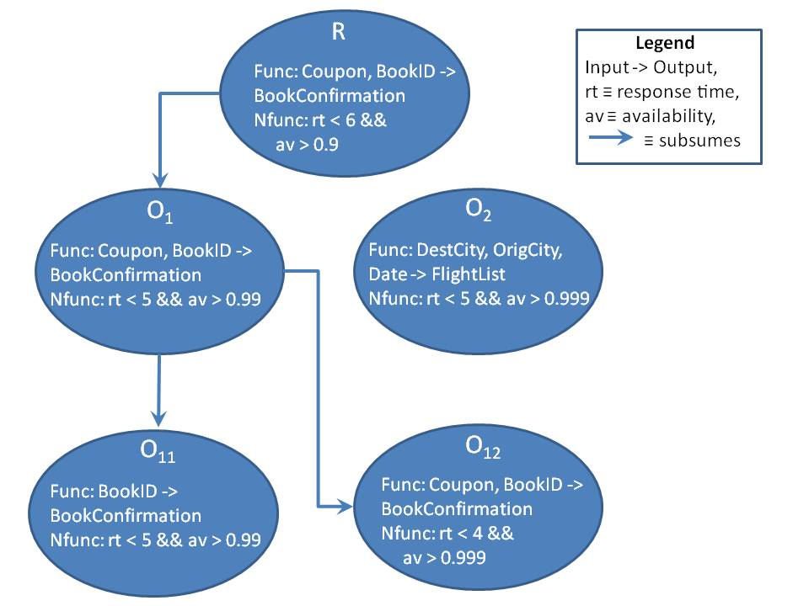
Subsumes Relation Example

Slide 9
Sequential Matchmaking Algorithm
Two versions:
Sequential: run funcMM first and then nonfuncMM based on the functional matchmaking results
SeqOnTheFly: run funcMM and on-the-fly filter the non-functional offers of the functional matches
Registration behaviour equivalent in both versions:
Register functional offer part in funcMM
Register combined entry in Combined Registry
Matchmaking complexity: O(R_{O} ∗ S ∗ R_{AO} + T_{Z})
Registration complexity: O(T_{Z} + S_{C})

Slide 10
Parallel Matchmaking Algorithm
Matchmaking: Use aspect-specific algorithms in parallel and then concatenate the results. Empty result from first algorithm finishing causes end of overall execution.
Registration: Similarly, again in parallel. Combined Registry also informed
Matchmaking complexity: O(S + T_{Z})
Registration complexity: O(max (S_{C}, logS + T_{Z}))

Slide 11
Subsumes Matchmaking Algorithm
Matchmaking: match request with each root node. If request subsumes node, then node and its descendants added to matchmaking results. Otherwise, continue recursively by going deeper into the children of the root node.
Registration: Start again from root nodes. If root node is subsumed, then offer becomes its parent. Otherwise, go recursively at node’s descendants until the offer is subsumed by one descendant but not by its children such that node is placed as child of this descendant.

Slide 12
Matchmaking Example
R
O₁
O₂
O₃
O₁₁
O₁₂
O₂₁
O₂₂
LEGEND
Match/subsumed node
O₂₂₁
O₂₂₂
Fail match node
Matching
Parent-child relationship

Slide 13
Registration Examples
O
O₁
O₁
O
O₁
O₁₁
O₁₂
O₁₁
O₁₁
O₁₂
O
LEGEND
Subsumed node
Subsumes node
Fail match node
Matching
Parent-child relationship

Slide 14
Subsumes Matchmaking Algorithm
Matchmaking Complexity:
Best Case:
Worst Case:
Registration Complexity:
Best Case:
Worst Case:
Average Case:

Slide 15
SubsumedBy Matchmaking Algorithm
Similar functionality to Subsumes
Matchmaking: Match request with each root node according to subsumes. If no match, no need to go down to node children. If match, node added in result set and respective node descendants are visited recursively.
Registration: Match offer with each root node. If offer is subsumed by the node, then it becomes its parent. Otherwise, if offer subsumes the node, we go recursively at node’s descendants until it is positioned as parent or child of a descendant. If offer is not positioned at any tree, it becomes another root node.

Slide 16
Matchmaking Example
R
O₁
O₂
O₃
O₁₁
O₁₂
O₂₁
O₂₂
LEGEND
Match/subsumed node
O₂₂₁
O₂₂₂
Fail match node
Matching
Parent-child relationship

Slide 17
Registration Examples
O
O₁
O₁
O
O₁
O₁₁
O₁₂
O₁₁
O₁₁
O₁₂
O
LEGEND
Subsumed node
Subsumes node
Fail match node
Matching
Parent-child relationship

Slide 18
Expectations
Matchmaking:
In worst case, Parallel best followed by Sequential
In best case, Parallel or subsumes could be the best
Registration:
Parallel is the best followed by Sequential

Slide 19
Experimental Evaluation
Exploited experimental framework in [1]
Input: OWLS-TC for functional aspect, randomized for non-functional aspect
1050 functional, 3 * 1050 non-functional (gold, silver, bronze)
Alive Functional MM [2] was exploited
Unary Non-Functional MM [1] was also exploited
OfferNum varied from 50 to 1050 with 200 step – 30 runs per step
Accuracy not considered as influence solely by the functional MM

Slide 20
Results

Slide 21
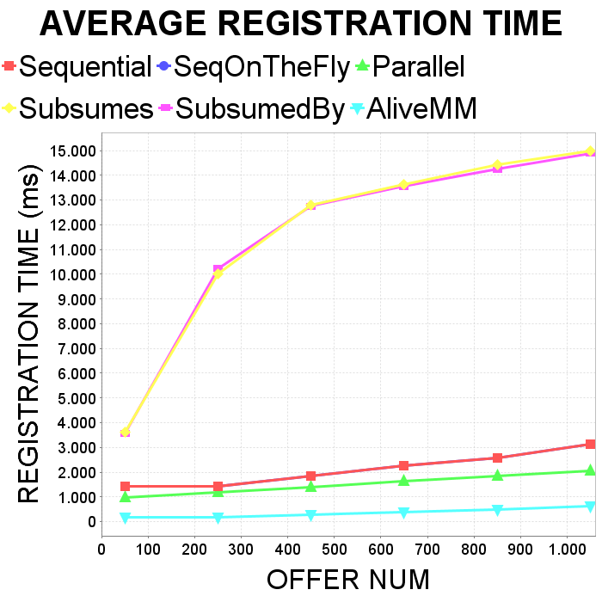

Slide 22
Future Work
Thorough validation of proposed algorithms
Completing development of the architecture
Consideration of service behaviour in matchmaking for better accuracy
Integration with existing service composition framework

Slide 23
References
Kritikos, K., Plexousakis, D.: Novel Optimal and Scalable Nonfunctional Service Matchmaking Techniques. IEEE T. Services Computing 7(4), 614–627 (2014)
Cliﬀe, O., Andreou, D.: Service Matchmaking Framework. Public Deliverable D5.2a, Alive EU Project Consortium (10 September 2009)

Slide 24
Backup Slides

Slide 25
Unified Service Discovery Architecture – Implementation
Java
Main implementation lang. for most matchmakers
REST via Jersey
Pellet Reasoner for ontology-based loading & consistency checking
Constraint Solvers: Ibex -> finite constraint solving & Choco – constraint programming
Alive Matchmaker as default functional service discovery algorithm
Unary Matchmaker as default non-functional service discovery algorithm

