Slide 1
BPaaS Allocation Environment Research Prototype
K. Kritikos
ICS-FORTH

Slide 2
Problem
Manual selection of cloud services
Impossible for large solution space
Individual selection at different levels leads to sub-optimal results
Design choices might be involved
Use external SaaS or deploy a software component as internal SaaS
Most cloud service allocation frameworks deal with one level
Low accuracy encountered due to non-consideration of semantics

Slide 3
Solution
Semantic service discovery to cover both functional and non-functional aspects & increase accuracy
Cross-level service selection to identify the best possible / optimal solutions
Benefits:
Automation in service selection
Bundle development time accelerated
Faster time-to-market for BPaaS bundles

Slide 4
Solution – Assumptions
Appropriate input is given:
Abstract BPaaS workflow annotated with semantic information
Non-functional requirements at global level at least are specified via OWL-Q
Camel model is given which defines the quantitative hardware requirements for internal sw components
Service registry existence:
Includes semantic functional & non-functional service advertisements

Slide 5
Solution – Service Discovery
Rely on state-of-the-art functional matchmaker (Alive) [1]
Exploit our work on non-functional matchmaking
Different approach types can be exploited:
Ontology-based relying on ontology subsumption [2]
Mixed approach: ontology alignment, CP model transformation, CP solving [3]
Combine aspect-specific matchmakers in innovative way [4] :
Performance-wise best combination: parallel

Slide 6
Solution – Service Selection [5]
Transform input to CP optimisation model & use CP solver to solve it
Smart utility functions used per non-functional metric to guarantee feasibility even for over-constrained requirements
Design choices are taken into account

Slide 7
Solution – Service Selection
Connection between different levels via functions
e.g., SW component QoS related to IaaS characteristics
Non-linear functions can be used (e.g., for availability)
High-level security requirements / capabilities are handled
Concurrent handling of IaaS & SaaS services
Solution time saving [6]: CP model parts fixed via exploitation of previous execution knowledge

Slide 8
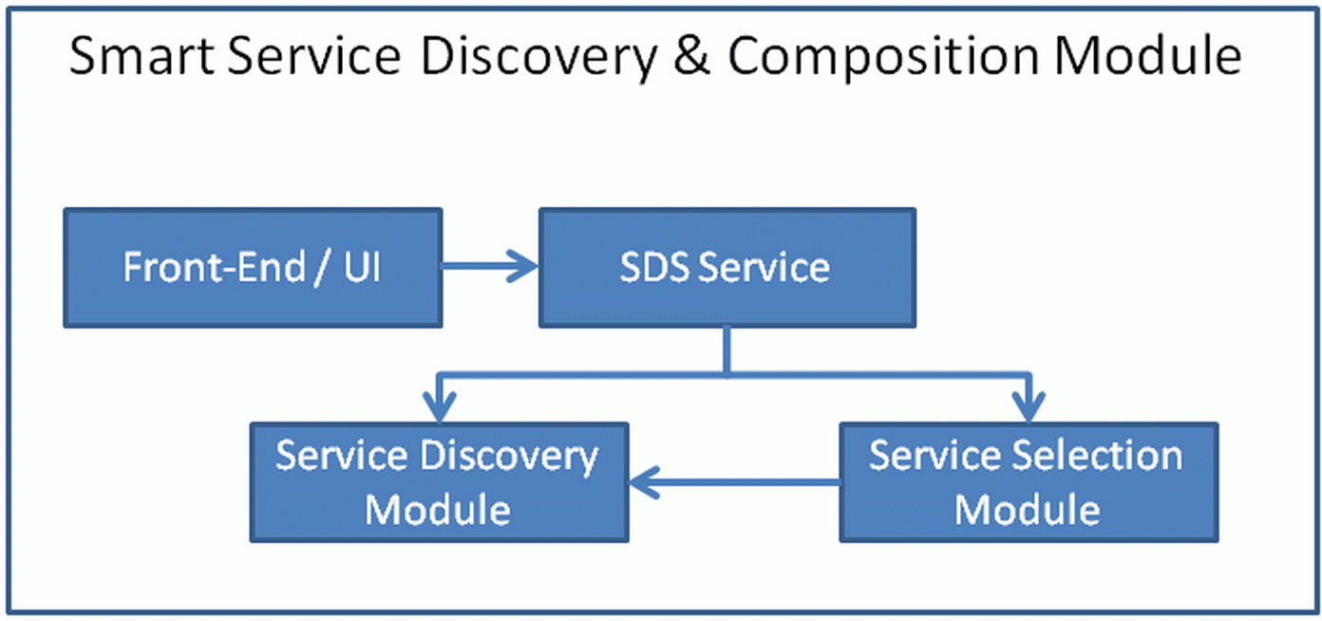
Overall Architecture

Slide 9
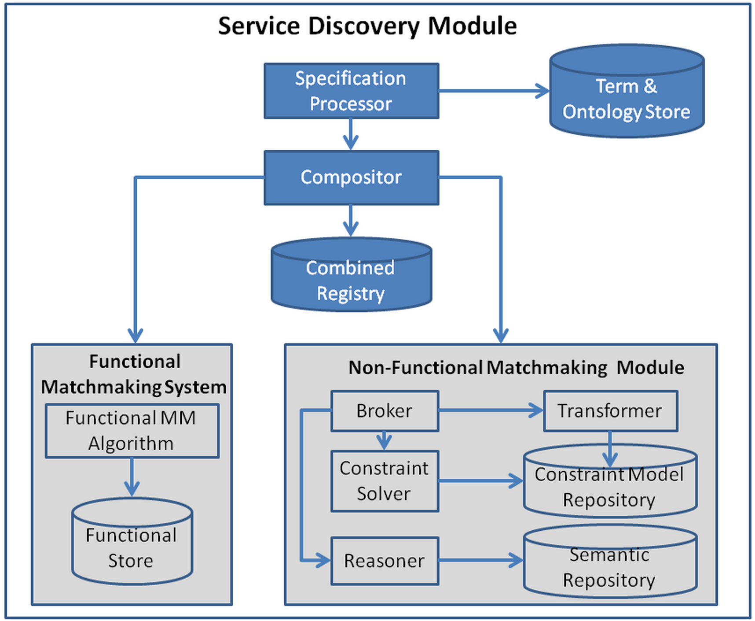
Service Discovery Module

Slide 10
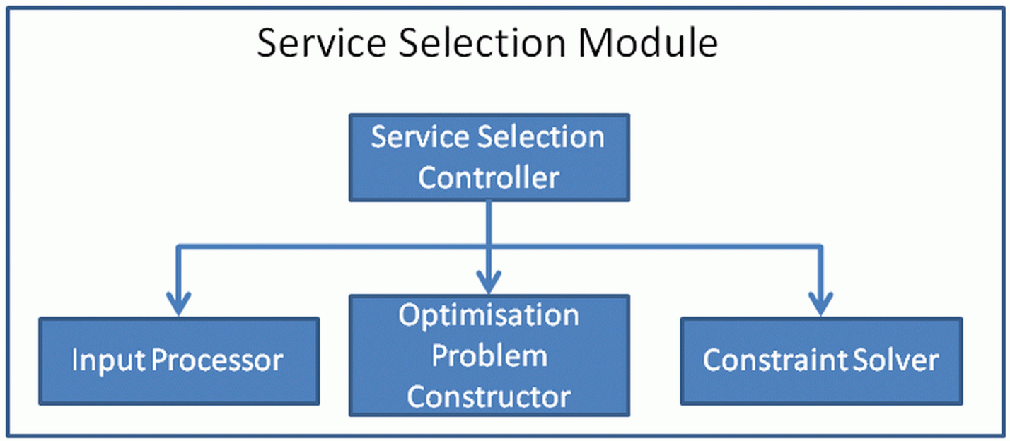
Service Selection Module

Slide 11
Showcase – BPaaS Allocation
Rely on Send Invoice use case
Service components allocation:
Invoice Ninja to IaaS services
CRM to SaaS services
Broker requirements:
global availability should be greater than 98%
total price per month should be less than 135 $
CRM service reliability should be greater than 0.8
CRM response time should be less or equal to 20 seconds
Invoice Ninja should be hosted on a VM with the following characteristics: 2 cores, 4 GBs of main memory and 20 GBs of hard disk. In addition, the OS for the VM should be ubuntu.

Slide 12
Showcase – Cloud Services
SaaS | availability | reliability | Response time | pricing
SugarCRM | 99.978 % | 0.85 | 10 sec | 10 $ / month
Zoho CRM | 99.9 % | 0.7 | 25 sec | 3 $ / month
YMENS CRM | 99.9 % | 0.8 | 20 sec | 7.5 $ / month
IaaS Name | Provider | Core Number | Memory Size | Storage Size | Availability | Pricing
t2.medium | Amazon | 2 | 4 GB | 20 GB | 99.95% | 0.172 $ / hour
t2.large | Amazon | 2 | 8 GB | 20 GB | 99.95% | 0.219 $ / hour
A2 V2 | Azure | 2 | 4 GB | 20 GB | 99.9 % | 0.136 $ / hour
F2 | Azure | 2 | 4 GB | 32 GB | 99.9 % | 0.221 $ / hour

Slide 13
Solution
Combination | Availability | Cost | Utility
SugarCRM + t2.medium | 99.928% | 133.84 | 0.7769
SugarCRM + A2 V2 | 99.87% | 107.92 | 0.7719
YMENS CRM + t2.medium | 99.85% | 131.84 | 0.5048
YMENS CRM + A2 V2 | 99.80% | 105.42 | 0.5000

Slide 14
References
Lam, J. S. C., Vasconcelos, W. W., Guerin, F., Corsar, D., Chorley, A., Norman, T. J., ... Nieuwenhuis, K. (2009). ALIVE: a framework for flexible and adaptive service coordination. In H. Aldewereld, V. Dignum, & G. Picard (Eds.), Engineering Societies in the Agents World X: 10th International Workshop, ESAW 2009 Utrecht, The Netherlands, November 18-20, 2009. Proceedings. (pp. 236-239). (Lecture notes in computer science; Vol. 5881). Berlin: Springer.
Kritikos, K., Plexousakis, D. (2016). Subsumption Reasoning for QoS-based Matchmaking. In ESOCC.
Kritikos, K., Plexousakis, D. (2014). Novel Optimal and Scalable Nonfunctional Service Matchmaking Techniques. IEEE T. Services Computing, 7(4), 614–627.
Kritikos, K., Plexousakis, D. (2016). Towards Combined Functional and Non-Functional Semantic Service Discovery. In ESOCC.
Kritikos, K., Plexousakis, D. (2015). Multi-Cloud Application Design through Cloud Service Composition. In Cloud, 686-693.
Kritikos, K., Magoutis, K., Plexousakis, D. (2016). Towards Knowledge-Assisted IaaS Selection. In CloudCom.

