Slide 1
WP3: BPaaS Research Execution Environment
PaaS Orchestration and Adaptation
Presenter: Frank Griesinger
Second Review, Brussels, February 8th, 2017
Notes:
Now as the bundle is complete, we can start with the Execution Environment. For that I will present you the PaaS Orchestration and Adaptation.

Slide 2
WP3: BPaaS Research Execution Environment: PaaS Orchestration and Adaptation
Research Problem:
How can we make use of Cloud providers on all layers?
➔ Orchestration
How can we adapt the deployment in a cross-layer way to fit the current needs?
➔ Adaptation
Notes:
Research questions -> Two Parts
Handover from Allocation Environment as the BPaaS bundle is created
Shortcomings of the Execution Environment
Currently only deployment on IaaS layer → Description and selection of service and provider is restricted
No means of exchanging services between layers
No means of monitoring external services in a unified way

Slide 3
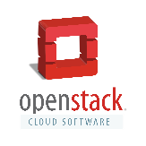
Motivating Example
Something happens to a component on the IaaS cloud provider.
Ensure a certain response time and availability.
Public IaaS cloud
BPaaS Bundle
Public PaaS cloud
Migration should happen.
Allowed and Availabe Cloud Infrastructures / Providers

Slide 4
Current State
Cloud-DSL CAMEL
only IaaS configuration
only scaling
Cloud Provider Engine
Cloud provider abstraction on IaaS
workflows as in CAMEL
only IaaS!
no complex adaptation

Slide 5
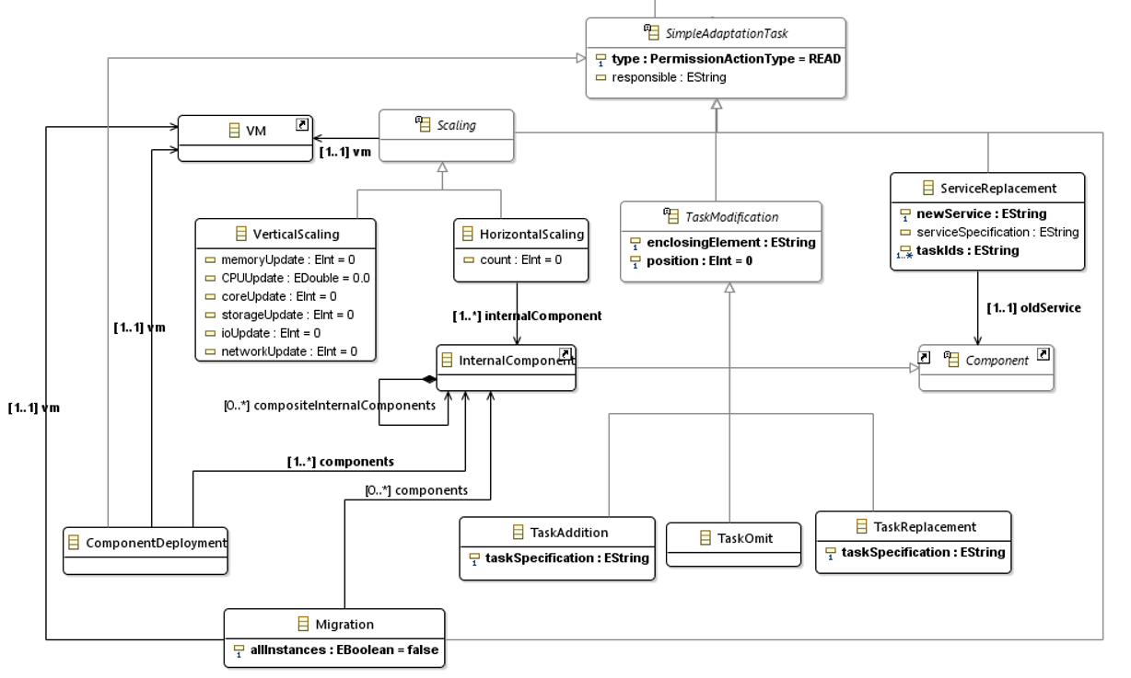
Solution Approach: Adaptation in CAMEL
Extension of CAMEL
mixed configurations and composed and complex tasks
Replace service with another one
Even change your application deployment and topology
Well-known
Scaling definitions
Task Modification
for Dynamic
React in case of violations by service migration

Slide 6
Solution Approach: Execution in the Cloud Provider Engine
Extension of Life Cycle Management in Cloud Provider Engine
PaaS Unified Library
Adaptation Management component
Cloud Provider Engine
IaaS
Sword
Dagger
PUL
PaaS
Adaptation Management

Slide 7
Demonstration: Motivating Example
Public IaaS cloud
BPaaS Bundle
Public PaaS cloud

Slide 8
Demonstration: PaaS Orchestration
IaaS
orchestrates
Scripts
PaaS
PaaS
requirements
Cloud Provider Engine
Sword
translates
Dagger
orchestrates
PUL

Slide 9
Demonstration: PaaS Integration (Video / Live)

Slide 10
Demonstration: Adaptation
<AdaptationTask>
DeployComponent
<AdaptationTask>
UpdateWorkflowDescription
<AdaptationTask>
DeleteComponent

Slide 11
Demonstration: Adaptation
<AdaptationTask>
DeployComponent
<AdaptationTask>
UpdateWorkflowDescription
<AdaptationTask>
DeleteComponent
Execution Environment
Cloud Provider Engine
Monitoring
Engine
Adaptation
Engine
Sword
Dagger
Workflow
Engine
PUL

Slide 12
Demonstration: Adaptation
<AdaptationTask>
DeployComponent
<AdaptationTask>
UpdateWorkflowDescription
<AdaptationTask>
DeleteComponent
Execution Environment
Cloud Provider Engine
Monitoring
Engine
Adaptation
Engine
Sword
Dagger
Workflow
Engine
PUL

Slide 13
Demonstration: Adaptation
<AdaptationTask>
DeployComponent
<AdaptationTask>
UpdateWorkflowDescription
<AdaptationTask>
DeleteComponent
Execution Environment
Cloud Provider Engine
Monitoring
Engine
Adaptation
Engine
Sword
Dagger
Workflow
Engine
PUL

Slide 14
Demonstration: Adaptation
<AdaptationTask>
DeployComponent
<AdaptationTask>
UpdateWorkflowDescription
<AdaptationTask>
DeleteComponent
Execution Environment
Cloud Provider Engine
Monitoring
Engine
Adaptation
Engine
Sword
Dagger
Workflow
Engine
PUL

Slide 15
Demonstration: Adaptation
<AdaptationTask>
DeployComponent
<AdaptationTask>
UpdateWorkflowDescription
<AdaptationTask>
DeleteComponent
Execution Environment
Cloud Provider Engine
Monitoring
Engine
Adaptation
Engine
Sword
Dagger
Workflow
Engine
PUL

Slide 16
Demonstration: Adaptation (Video / Live)

Slide 17
WP3: BPaaS Research Execution Environment: PaaS Orchestration and Adaptation
Added Value:
deploy components at a bigger variety of Cloud providers
describe components on multiple ways and per Cloud layer on a provider-independent way
allow to describe adaptation plans, e.g. switch provider at run-time or adapt to new conditions

Slide 18
WP3: BPaaS Research Execution Environment: PaaS Orchestration and Adaptation

Slide 19
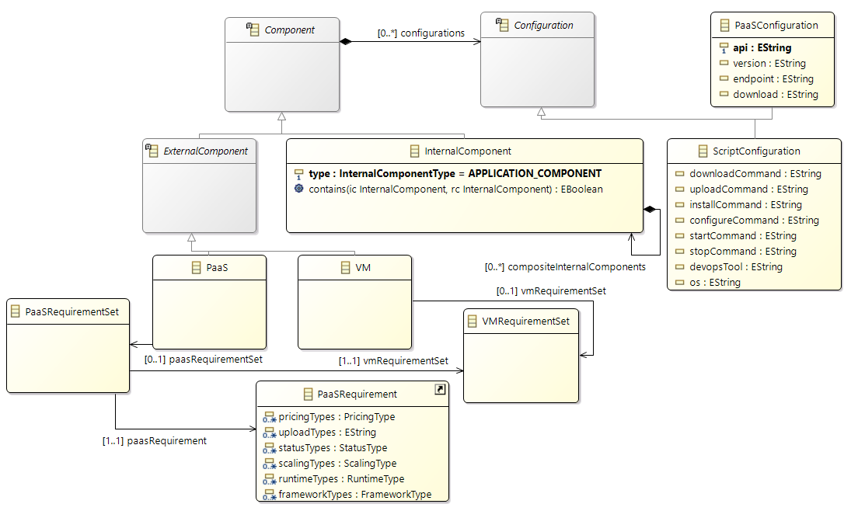
Solution Approach: PaaS in CAMEL
CAMEL extensions towards PaaS deployment
excerpt from the CAMEL configuration additions
PaaS and IaaS configuration come along with the same
Component description
Combine PaaS-specific requirements and re-use hardware requirements

Slide 20
Demonstration: Adaptation Plan Description
Adaptation description for a migration in CAMEL as executed by the Adaptation Management component
<MonitorSubscription>
ResponseTimeRule
<Sensor>
ResponseTimeSensor
<Component>
InvoiceNinja
triggers
references
<AdaptationTask>
DeployComponent
<AdaptationTask>
UpdateWorkflowDescription
<AdaptationTask>
DeleteComponent

Slide 21
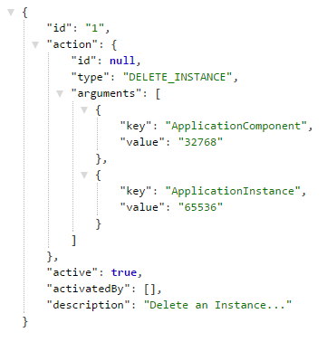
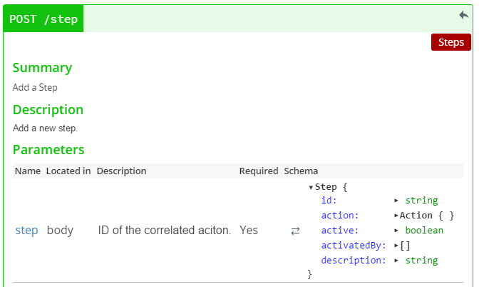
Solution Approach: Adaptation Management component
Development of Adaptation Management component that exposes the Cloud Provider Engine and manages the adaptation plans
Plans are composed of single steps
Notes:
Adaptation Management REST interface:
API allows to add steps with their relation to create an adaptation plan in the end.
Steps are either activated by external events or precessors.
Implementation of Action Types as declared in the CAMEL specification.
Currently implemented migration actions and workflow engine adaptations.

Slide 22
DEMONSTRATION: CURRENT SET-UP
Cloud Provider Engine
Workflow
Engine
Creating a workflow instance
SLA
Engine
IaaS component description
Show KPI violations
PaaS component description
IaaS component instance
PaaS component instance
Adaptation Management
Show adaptation plan

Slide 23
DEMONSTRATION: UPDATED SET-UP
Cloud Provider Engine
Workflow
Engine
Creating a workflow instance
SLA
Engine
IaaS component description
Show KPI violations
PaaS component description
IaaS component instance
PaaS component instance
Adaptation Management
Show adaptation plan

Slide 24
DEMONSTRATION: STORY
Public IaaS cloud
BPaaS Bundle
Public PaaS cloud
Allowed and Availabe Cloud Infrastructures / Providers

Slide 25
DEMONSTRATION: STORY
Public IaaS cloud
BPaaS Bundle
Public PaaS cloud

Slide 26
DEMONSTRATION: ADAPTATION
<AdaptationTask>
DeployComponent
<AdaptationTask>
UpdateWorkflowDescription
<AdaptationTask>
DeleteComponent
Execution Environment
Cloud Provider Engine
Monitoring
Engine
Adaptation
Engine
Sword
Dagger
Workflow
Engine
PUL

Slide 27
Demonstration
Excerpt of PaaS description in CAMEL
All these in the same component description.
configurations:
{
type: PaaSConfiguration,
api: „PUL“,
…
},
{
type: ScriptConfiguration,
os: Ubuntu
installCommand: „…“
}
requirements:
{
type: PaaSRequirement,
name: „invoiceNinjaRequirement“,
runtimeTypes: „Java“,
minVersion: „7.0“
},
{
type: QuantitativeHardwareRequirement,
minCPU: 1,
…
}

Slide 28
Step 1: Orchestration of PaaS components
CAMEL extensions
As generated from the Allocation Environment
Put image of camel file /bunde with several descriptions, paas and iaas scripts

Slide 29
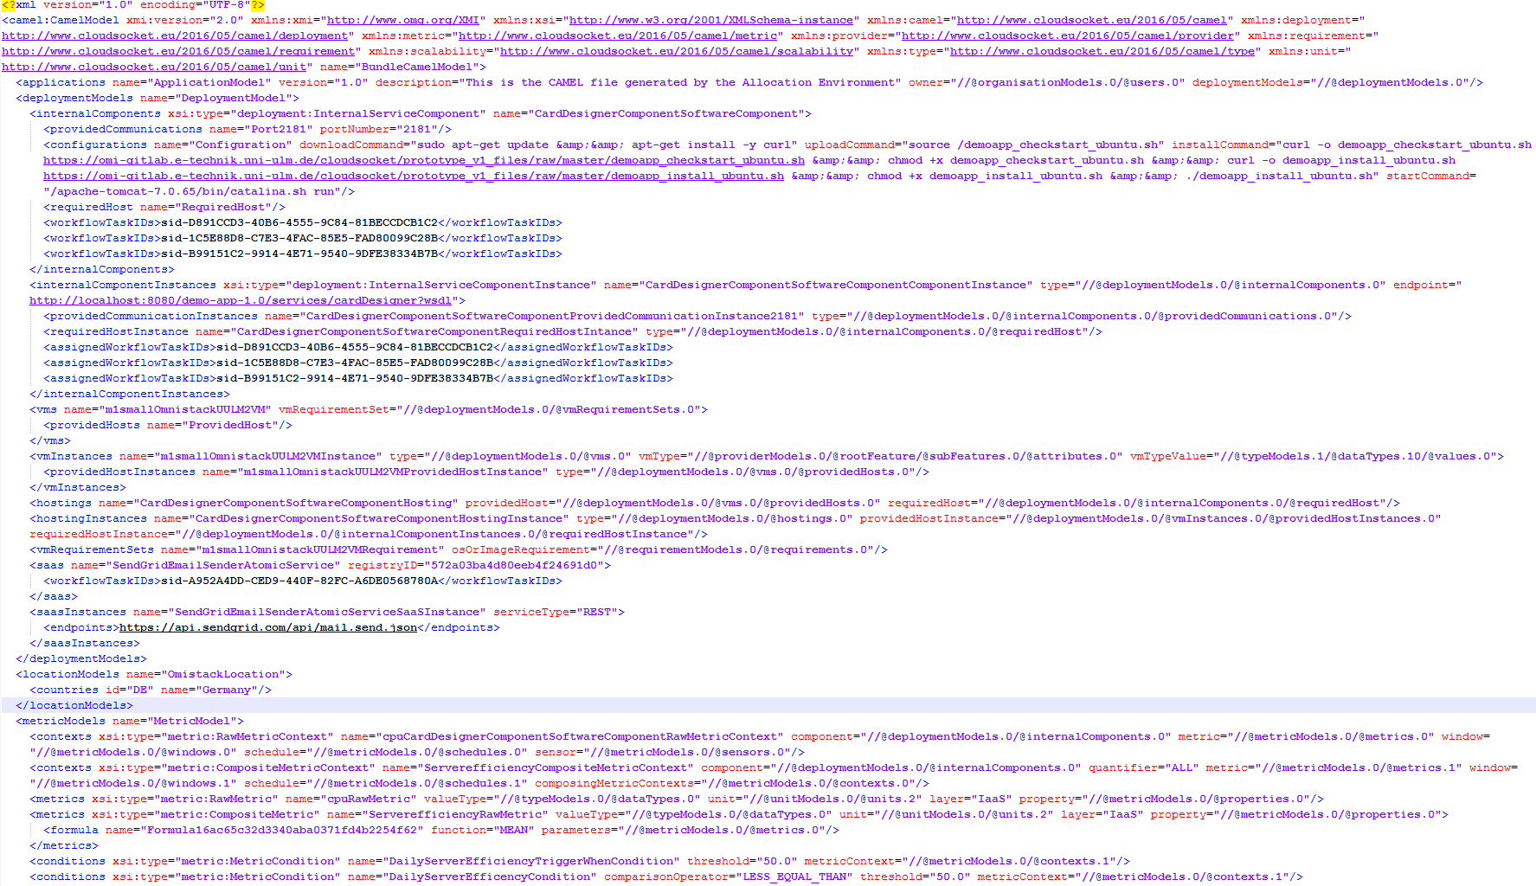
WP3: BPaaS RESEARCH ALLOCATION ENVIRONMENT: DMN-TO-CAMEL-MAPPER
business values
Broker
business values
technical values
Allocation Environment
Engineer
BPaaS Bundle

Slide 30
WP3: BPaaS RESEARCH ALLOCATION ENVIRONMENT: DMN-TO-CAMEL-MAPPER
high-level values
Broker
high-level values
high-level values
BPaaS Bundle

Slide 31
WP3: BPaaS RESEARCH ALLOCATION ENVIRONMENT: DMN-TO-CAMEL-MAPPER
business values
Broker
business values
technical values
again full
iteration required?
changing´values:
expected # of customers from 50 to 200
Allocation Environment
Engineer
BPaaS Bundle

Slide 32
WP3: BPaaS RESEARCH ALLOCATION ENVIRONMENT: DMN-TO-CAMEL-MAPPER
business values
technical values
Broker
business values
Business IT-aligned CAMEL creation
Decision Layer
DMN™
BPaaS Bundle

Slide 33
WP3: BPaaS RESEARCH ALLOCATION ENVIRONMENT: DMN-TO-CAMEL-MAPPER
Decision Layer
DMN™
Decision Model And Notation
standardized
human readable as Decision Table (DT)

Slide 34
WP3: BPaaS RESEARCH ALLOCATION ENVIRONMENT: DMN-TO-CAMEL-MAPPER
comprises multiple sub models
provider models
deployment models
monitoring models
scalability models
Decision Layer

Slide 35
WP3: BPaaS RESEARCH ALLOCATION ENVIRONMENT: DMN-TO-CAMEL-MAPPER
DMN Table Modelling

Slide 36
WP3: BPaaS RESEARCH ALLOCATION ENVIRONMENT: DMN-TO-CAMEL-MAPPER
input: set of business/technical values
Decision Layer
DMN™
output: CAMEL fragment A
output: CAMEL fragment B

Slide 37
WP3: BPaaS RESEARCH ALLOCATION ENVIRONMENT: DMN-TO-CAMEL-MAPPER
busniess values
CAMEL fragments
Architecture
ADOxx
Camunda
DMN Modelling Environment
REST API
DMN-to-CAMEL-Mapper
DMN Table Repository
Requirement
Mapper
CAMEL
Composer
DMN Execution Engine
CAMEL Fragment Repository

Slide 38
WP3: BPaaS RESEARCH ALLOCATION ENVIRONMENT: DMN-TO-CAMEL-MAPPER
Prototype:
DMN-to-CAMEL-Mapper

Slide 39
WP3: BPaaS RESEARCH ALLOCATION ENVIRONMENT: DMN-TO-CAMEL-MAPPER
Added Value:
aligning cloud modelling with business values
easing the CAMEL creation
reusability of modelled decision tables

Slide 40
WP3: BPaaS RESEARCH ALLOCATION ENVIRONMENT: DMN-TO-CAMEL-MAPPER

Slide 41
WP3: BPaaS RESEARCH ALLOCATION ENVIRONMENT: DMN-TO-CAMEL-MAPPER
show workflow: broker creates easily a new CAMEL model and with it a new BPaaS bundle and published it to marketplace

Slide 42
WP3: BPaaS RESEARCH ALLOCATION ENVIRONMENT: DMN-TO-CAMEL-MAPPER
From a concrete service to a software component?
BPaaS Allocation Environment
high-level values
cloud specification
software component specification
monitoring specification
adaptation specification
high-level values
high-level values

Slide 43
WP3: BPaaS RESEARCH ALLOCATION ENVIRONMENT: DMN-TO-CAMEL-MAPPER
From a concrete service to a software component?
BPaaS Allocation Environment
cloud specification
software component specification
monitoring specification
adaptation specification
complex!
requires deep technical knowledge!

Slide 44
WP3: BPaaS RESEARCH ALLOCATION ENVIRONMENT: DMN-TO-CAMEL-MAPPER
From a concrete service to a software component?
BPaaS Allocation Environment
cloud specification
software component specification
monitoring specification
adaptation specification
changing high-level values?

Slide 45
WP3: BPaaS RESEARCH ALLOCATION ENVIRONMENT: DMN-TO-CAMEL-MAPPER
From a concrete service to a software component?
BPaaS Allocation Environment
complex (400 lines of XML)!
requires deep technical knowledge!

Slide 46
WP3: BPaaS RESEARCH ALLOCATION ENVIRONMENT: DMN-TO-CAMEL-MAPPER
From a concrete service to a software component?
complex!
requires high technical knowledge!

Slide 47
DEMONSTRATION: STORY
SaaS
BPaaS Bundle
PaaS
IaaS
Allowed and Availabe Cloud Infrastructures / Providers

