Slide 1
Context-Adaptive Questionnaire for Business-IT Alignment
Research Question: How can semantic lifting and service discovery be performed more intuitively and efficiently?
Notes:
Semantic lifting approach and service discovery solution are both improved

Slide 2
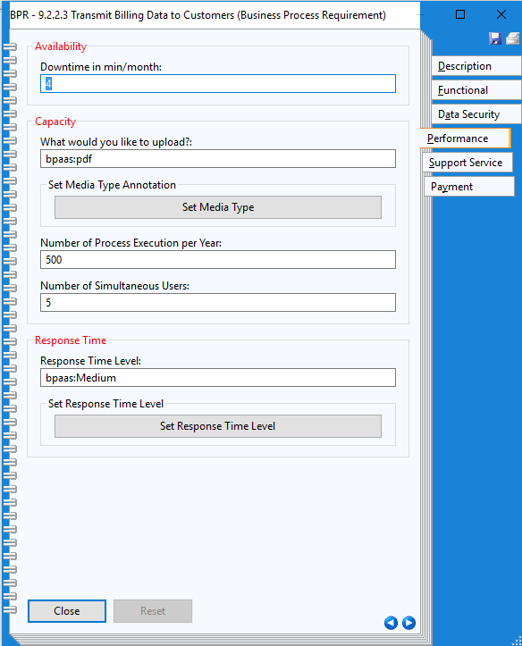
Business Requirements by Questionnaire

Slide 3
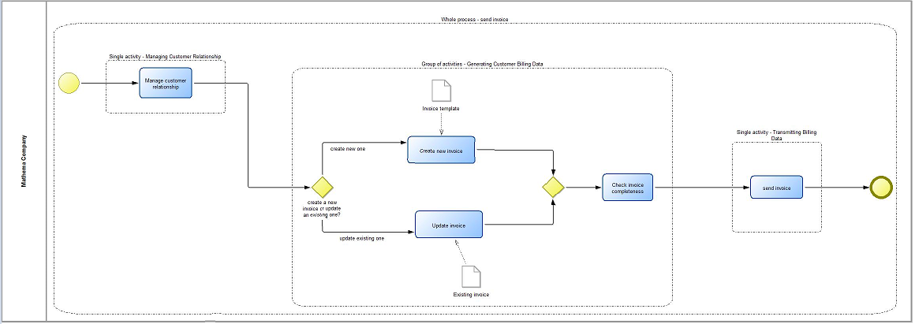
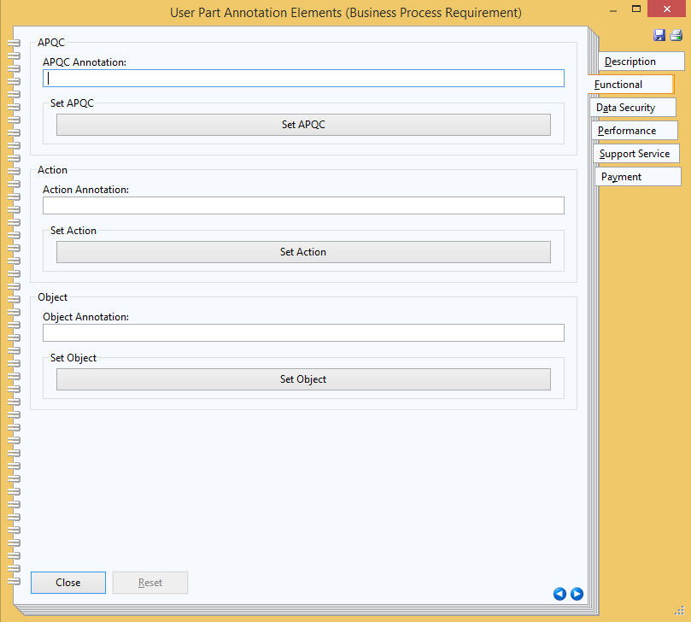
Service Requirements for Business Processes
Business Process Model: BPMN

Slide 4
Service Requirements for Business Processes
Business Process Model: BPMN

Slide 5
Requirements Specification with a Questionnaire
Identify as early as possible, if a service is available or not
Ask only relevant questions
Entropy
Domain-Specifc dependency
Attribute dependency
User-centric question flow
First functional requirements
Non-functional requirements of the selected domain

Slide 6
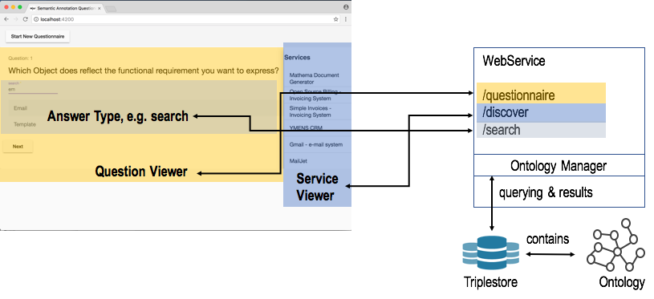
General Architecture

