Slide 1
BPaaS Semantic Modeler
Research Question:
How can a modeling environment support consistency between human and machine interpretation of BPaaS models for the Business-IT alignment?

Slide 2
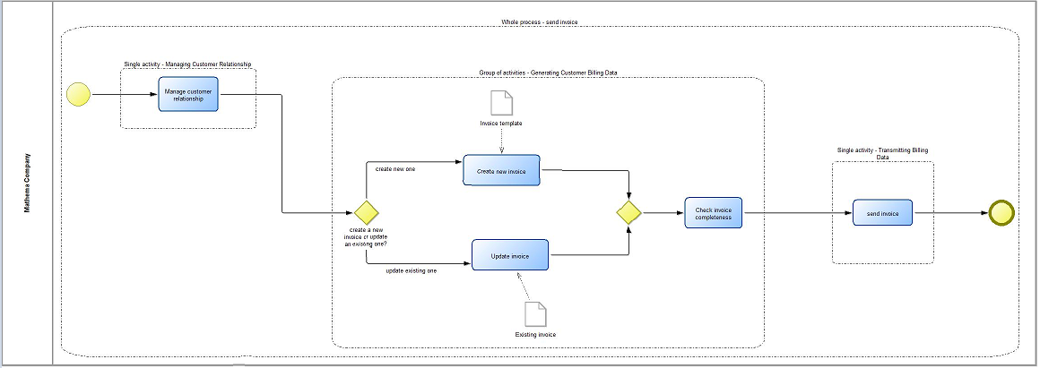
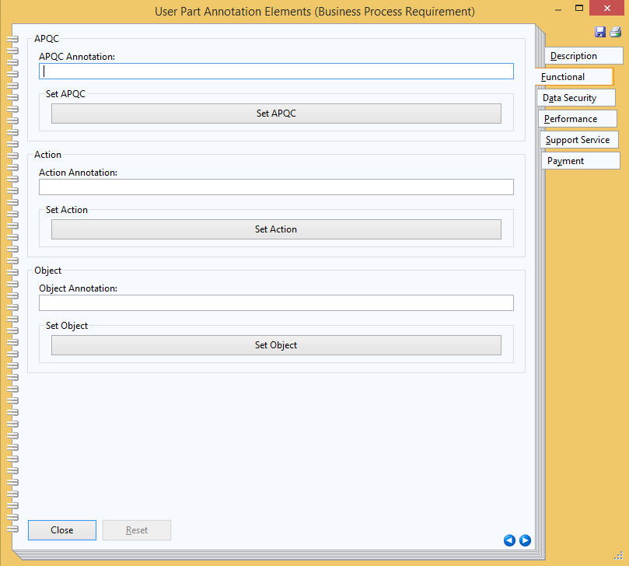
Service Requirements for Business Processes
Business Process Model: BPMN

Slide 3
Workflow Descriptions
Workflow Model: BPMN
Workflow
Description
Workflow
Description
Workflow
Description
Notes:
Lanes refer to workflow descriptions that specify cloud services.

Slide 4
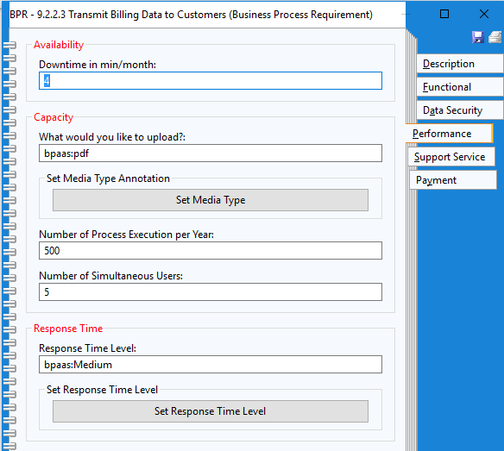
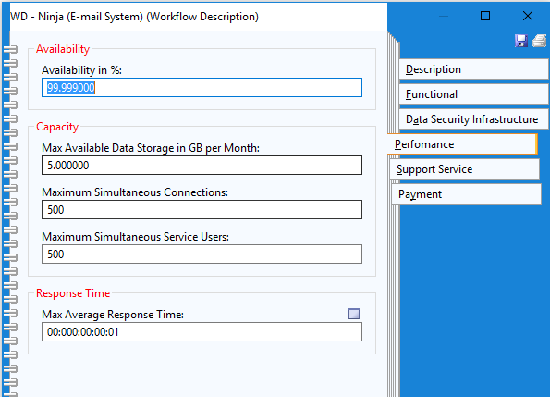
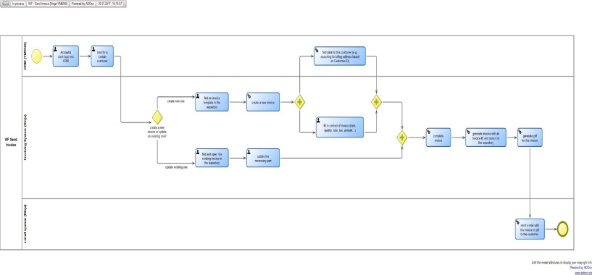
Mapping Business Requirements to Workflow Descriptions
Workflow
Description

Slide 5
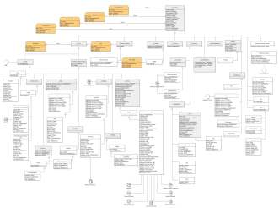
BPaaS Design Environment: Human and Machine Interpretation
human interpretation
informal and semi-formal
machine interpretation
formal
BPaaS Modelling Environment
BPaaS Ontology
Inference
Meta model
Classes/Rules
semantic
alignment
semantic
annotations
Models
Smart Business and IT in the Cloud Alignment
Workflow
transformation
and mapping
Process
Triple Store Repository

Slide 6
Semantic Lifting with the Modeling Ontology Connector
The human-interpretable models are enriched with semantics in order to support business and IT alignment with smart technology.
2.
1.
BPaaS Modelling Environment
BPaaS Ontology
Web Service
3.
Inference
4.
Ontologies
Classes/Rules
Meta model
semantic
alignment
semantic
annotations
Models
Smart Business and IT in the Cloud Alignment
transformation
and mapping
Triple Store Repository

